Slide 1
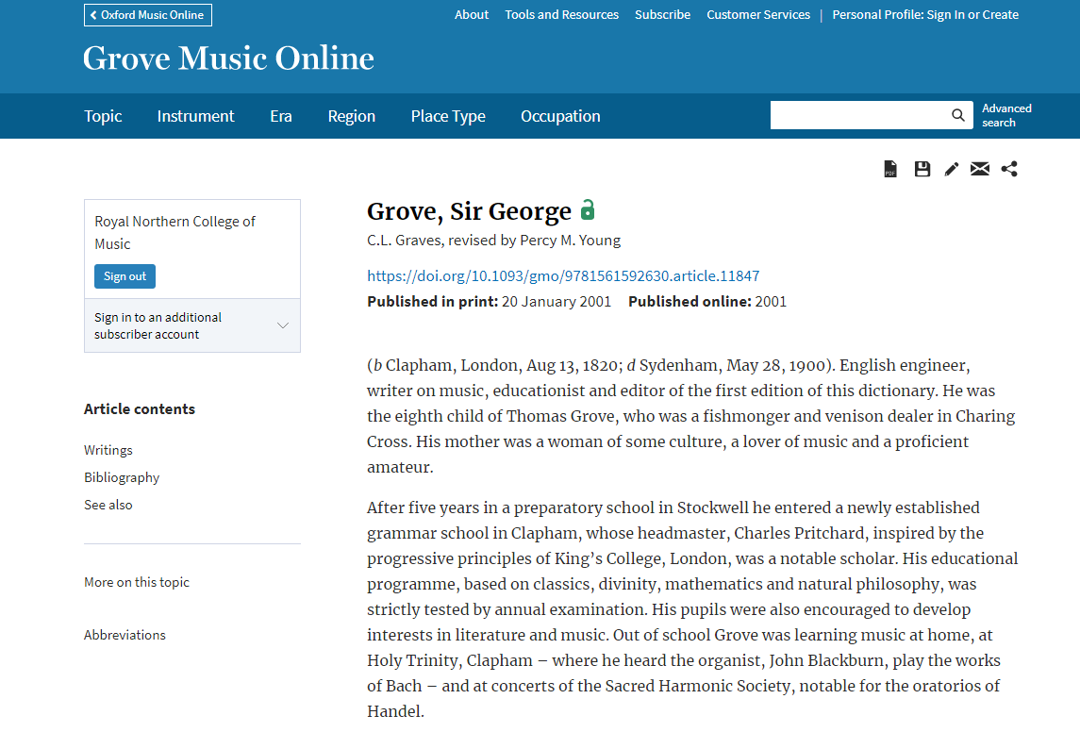


Using Grove Music Online

Slide 2
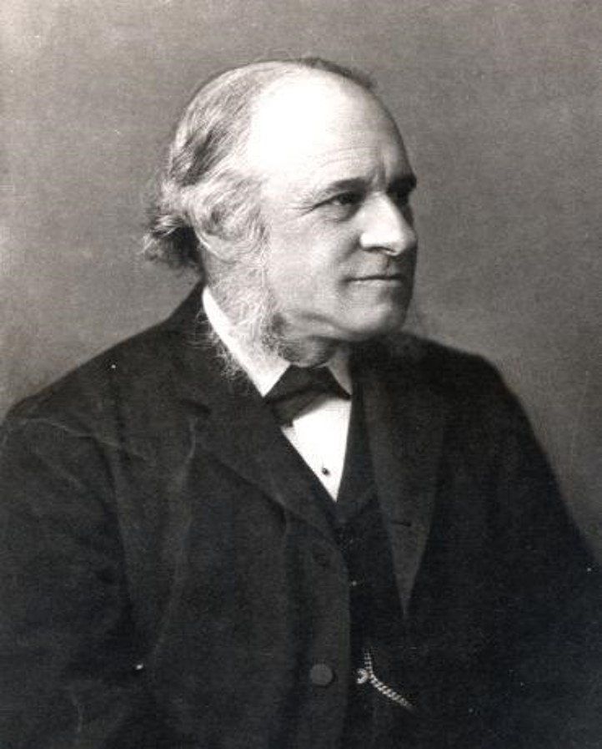
Sir George Grove
(1820-1900)
Director of the Royal
College of Music
1883-1894

Slide 3
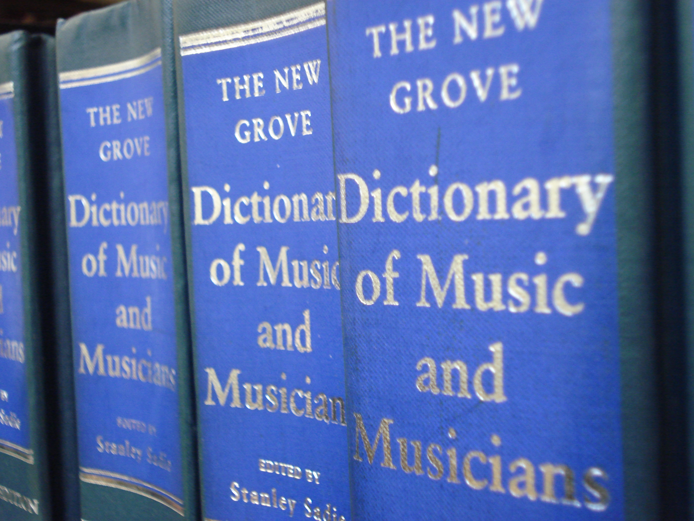
Groves dictionary of music and musicians
1st edition 1879-1889
2nd edition 1904-1910
3rd edition 1927
4th edition 1940 /1945
5th edition 1954
As New Grove dictionary of music and musicians
1st edition 1980
2nd edition 2001

Slide 4
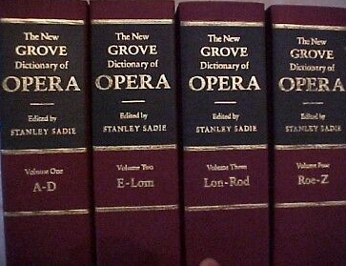
American music
Jazz
New Grove family – incorporated into the online version
Opera
Musical instruments
Women composers

Slide 5
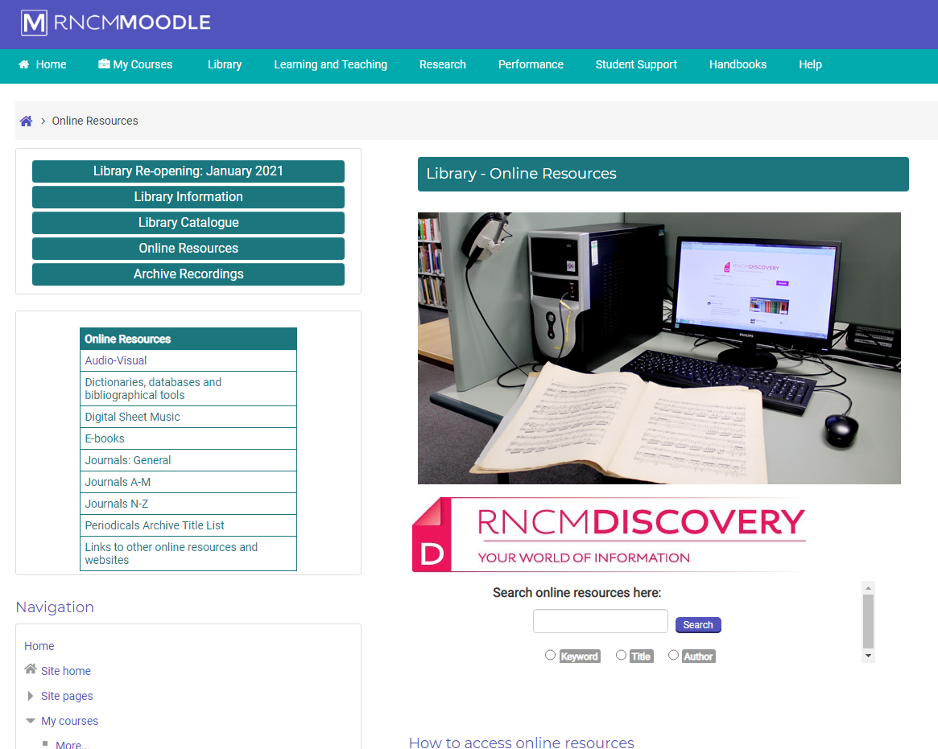

Slide 6
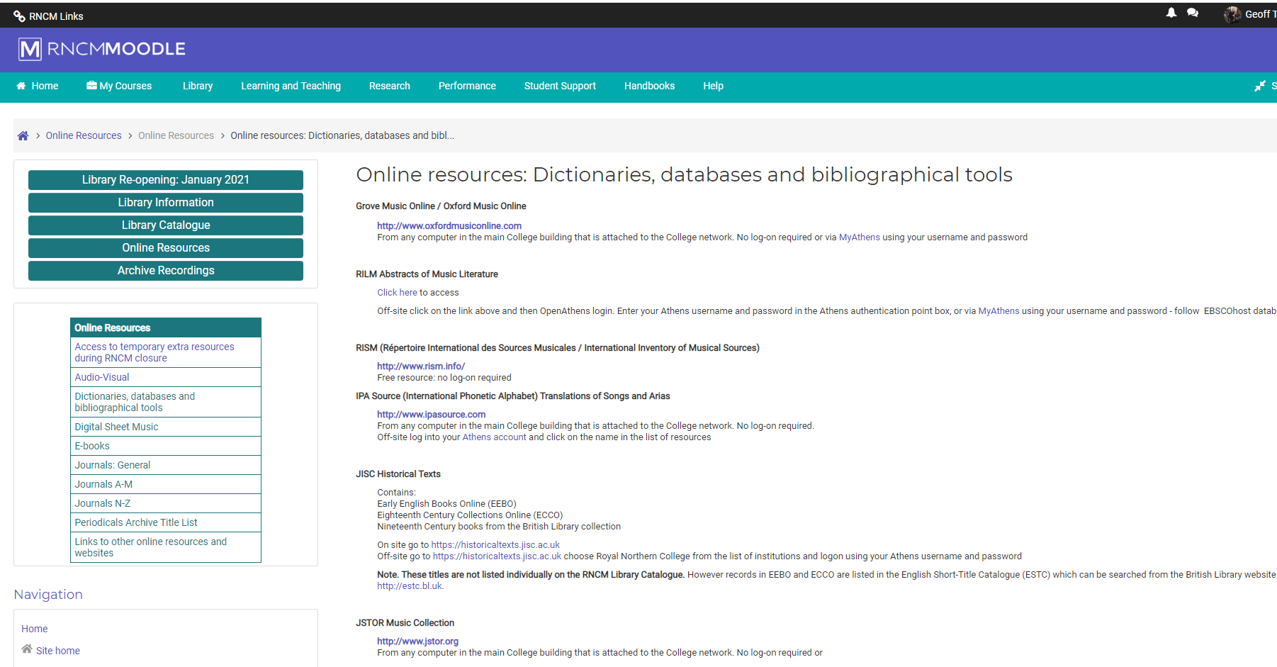

Slide 7
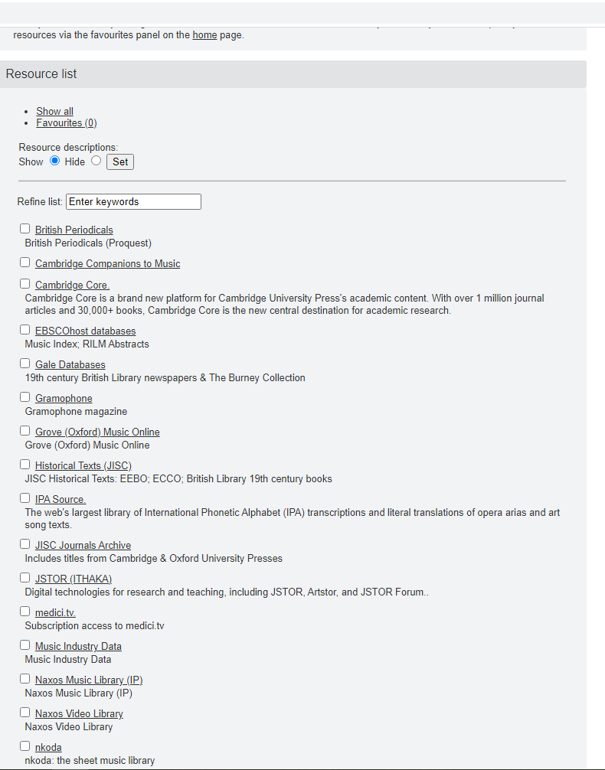
www.openathens.net

Slide 8
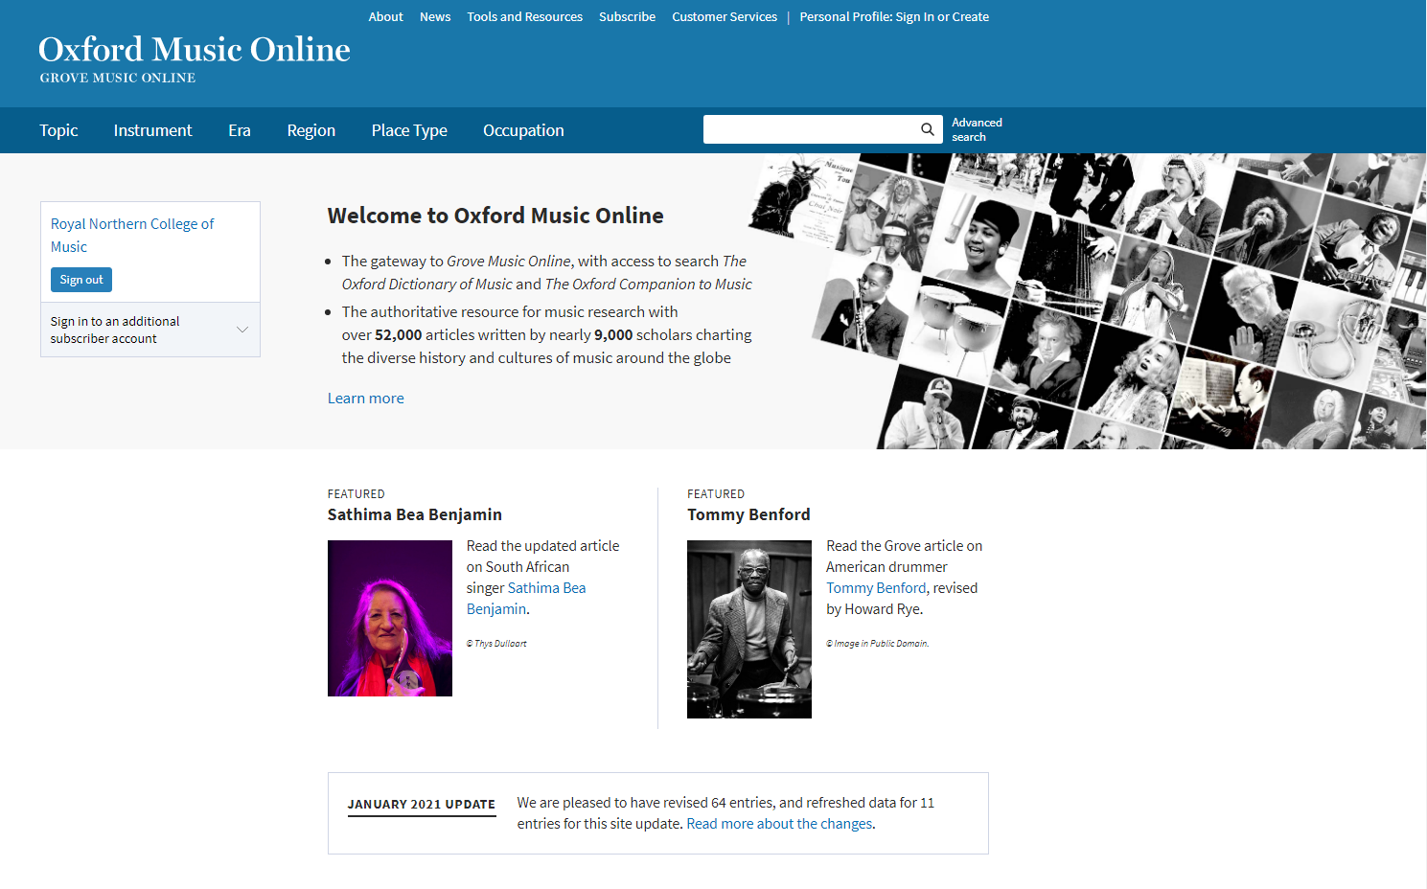
Stravinsky

Slide 9
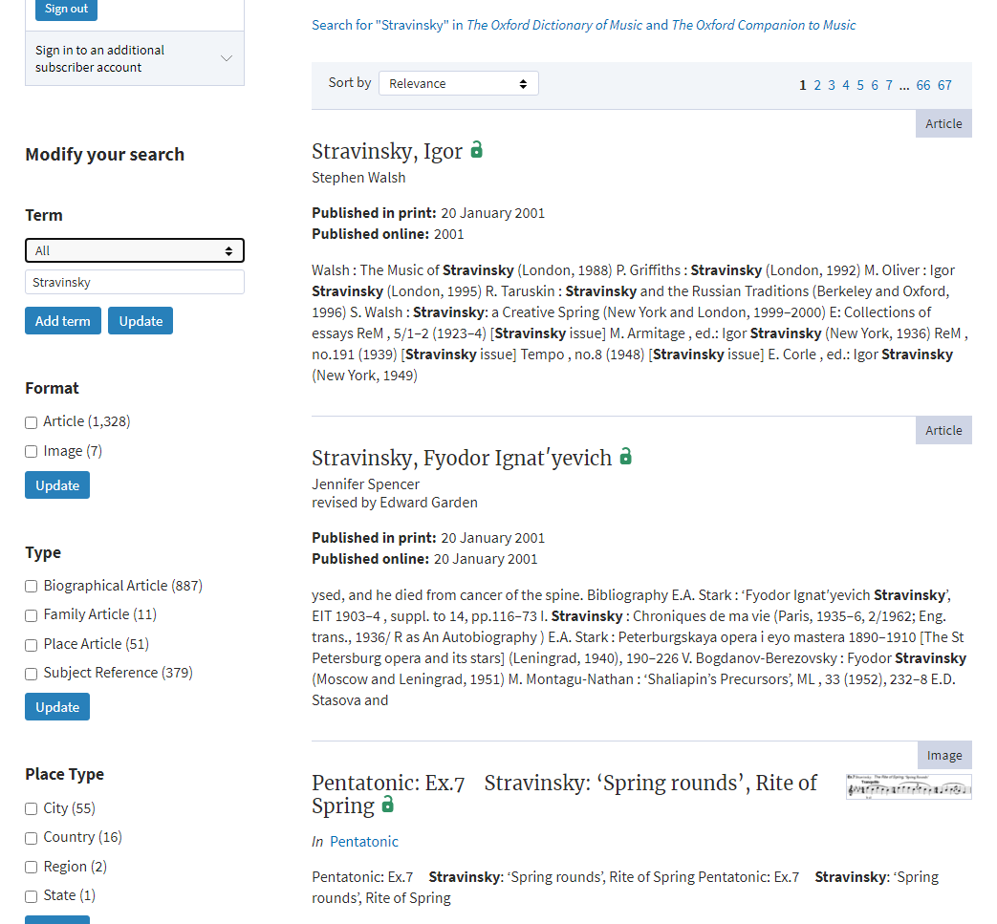
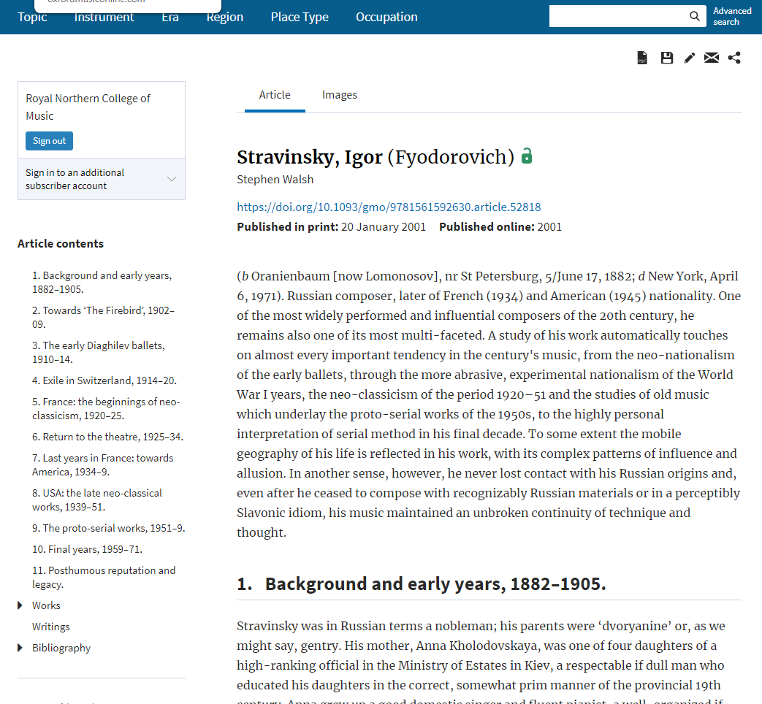

Slide 10
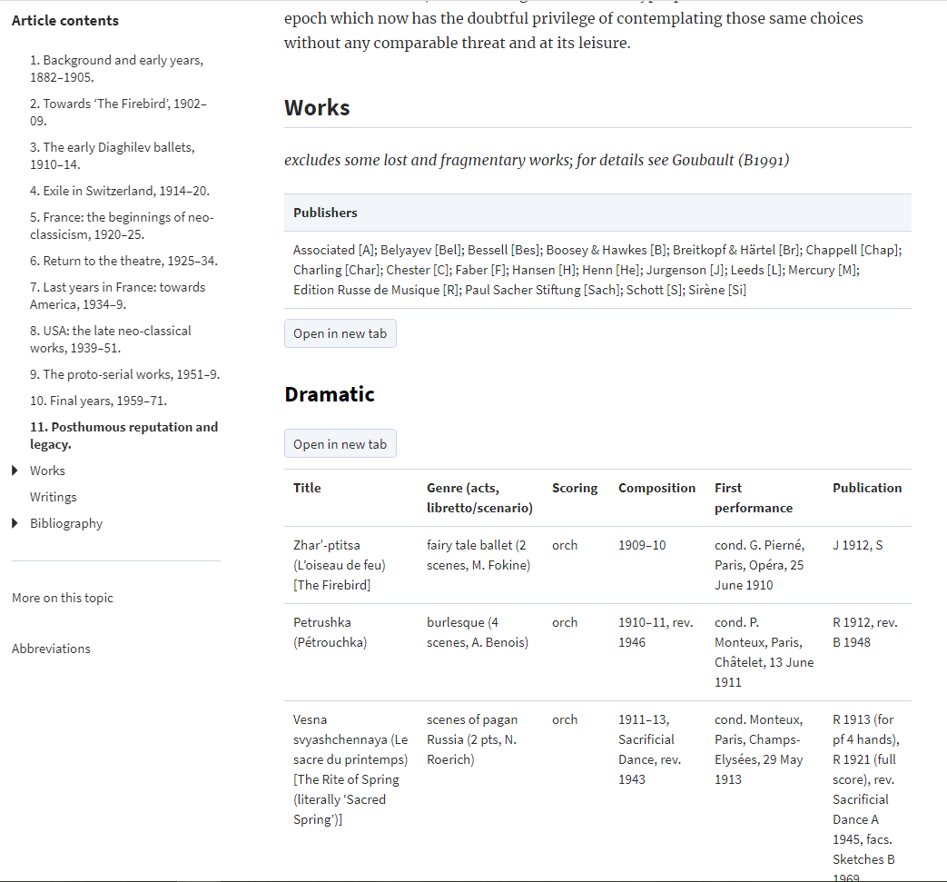
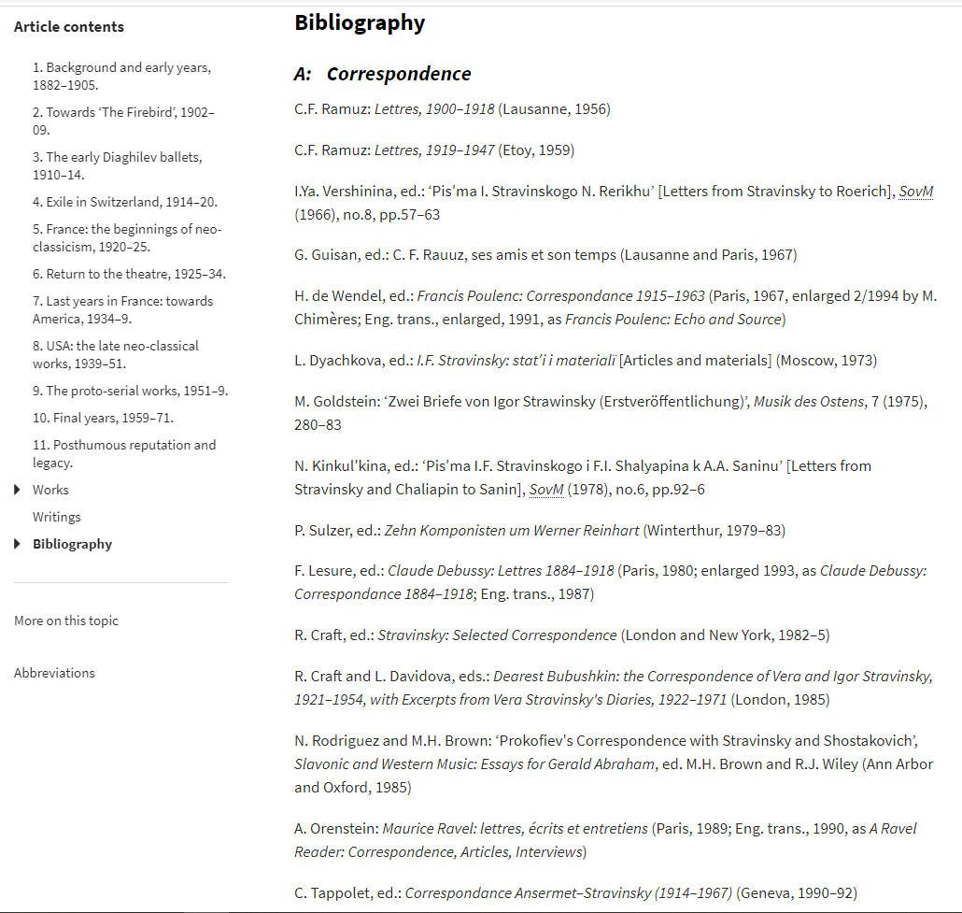

Slide 11
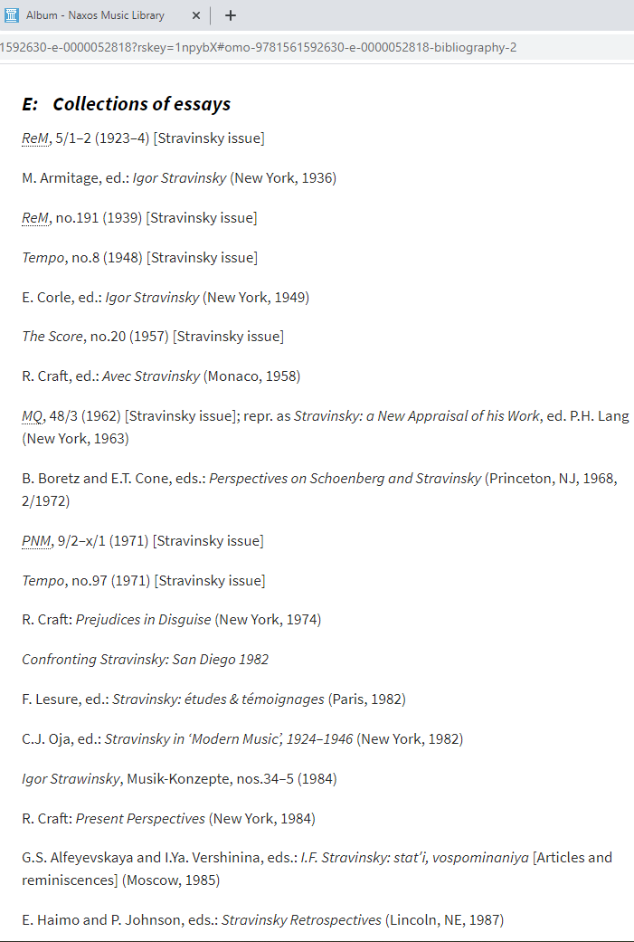
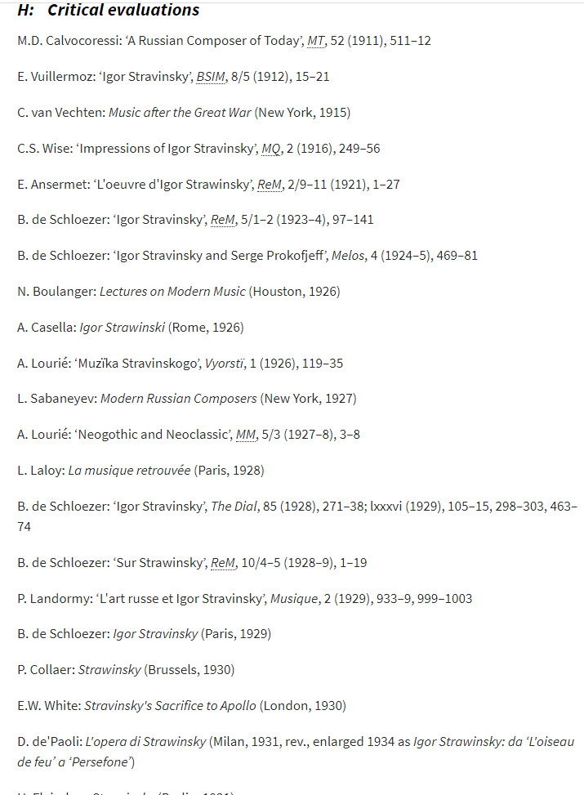
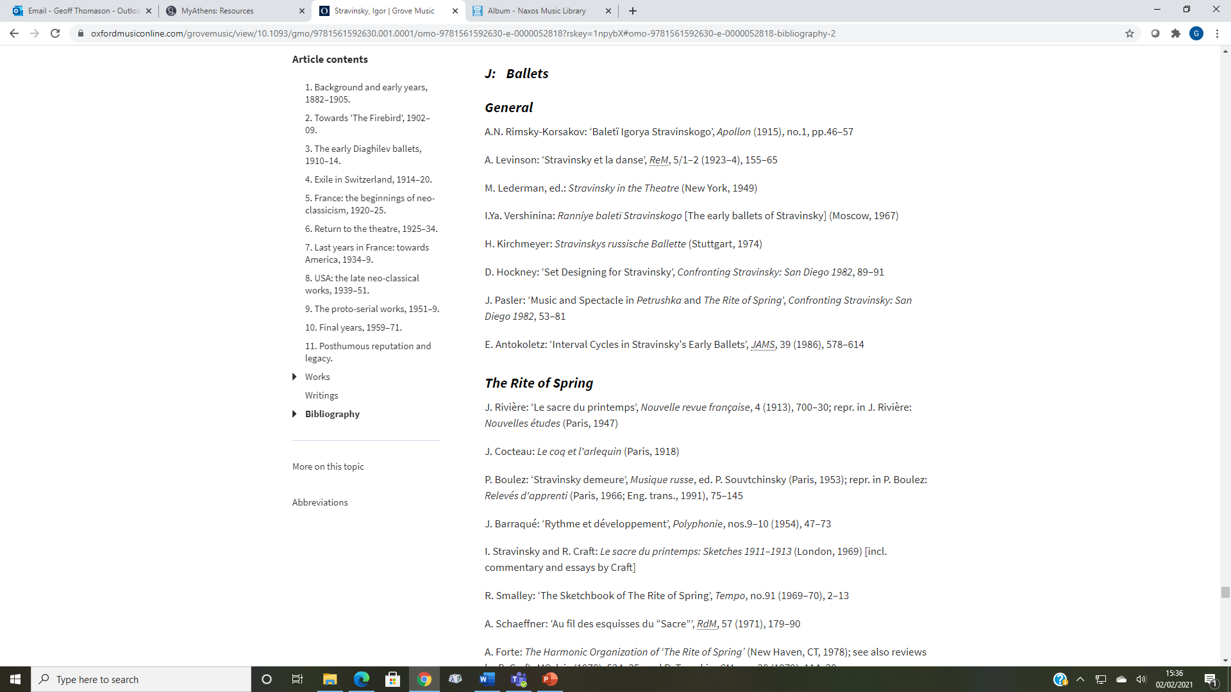

Slide 12
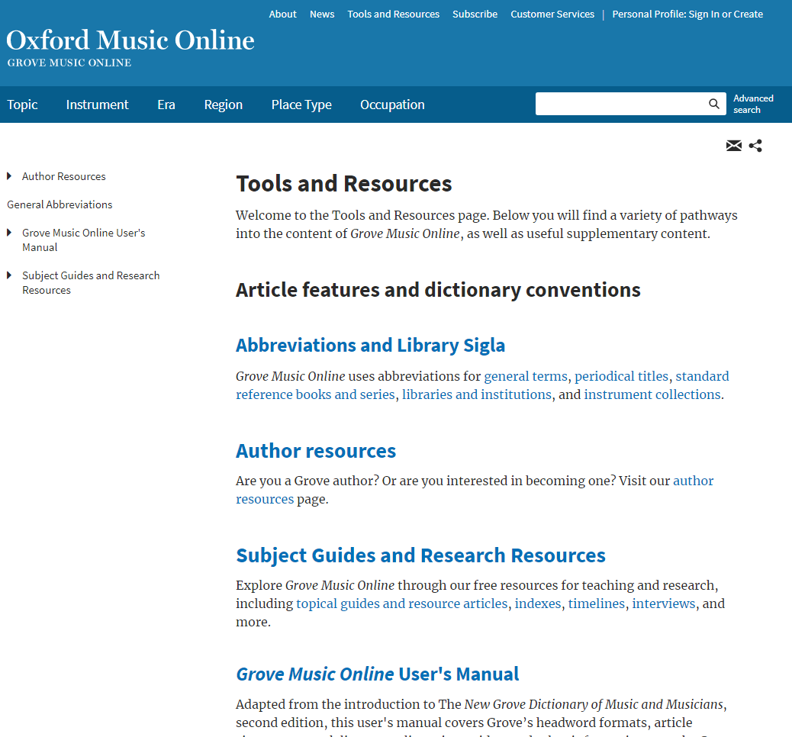
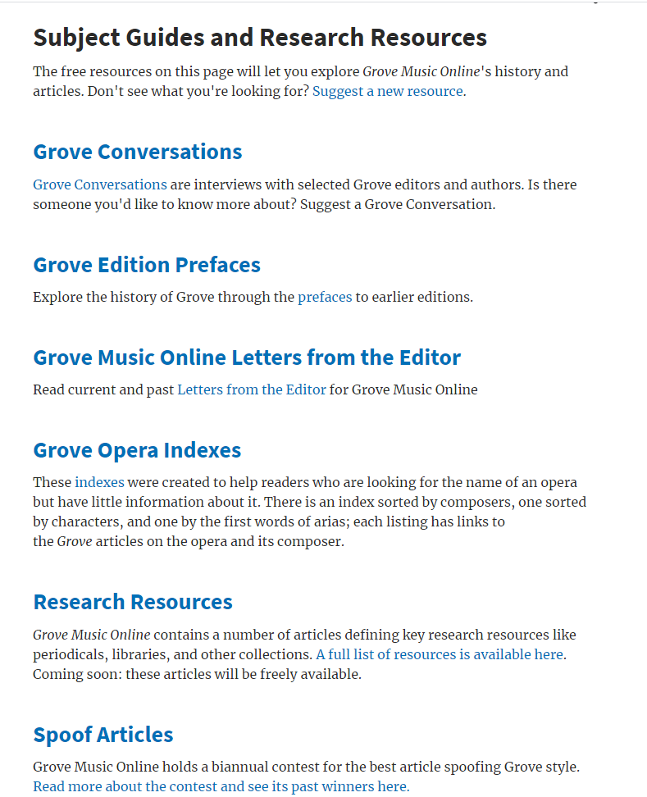

Slide 13
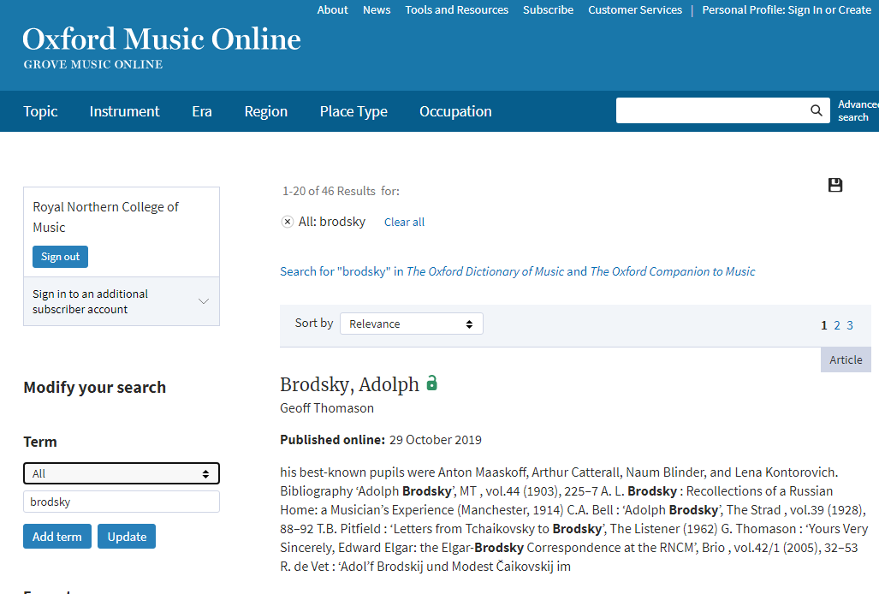
libstaff@rncm.ac.uk
geoff.thomason@rncm.ac.uk

