Slide 1
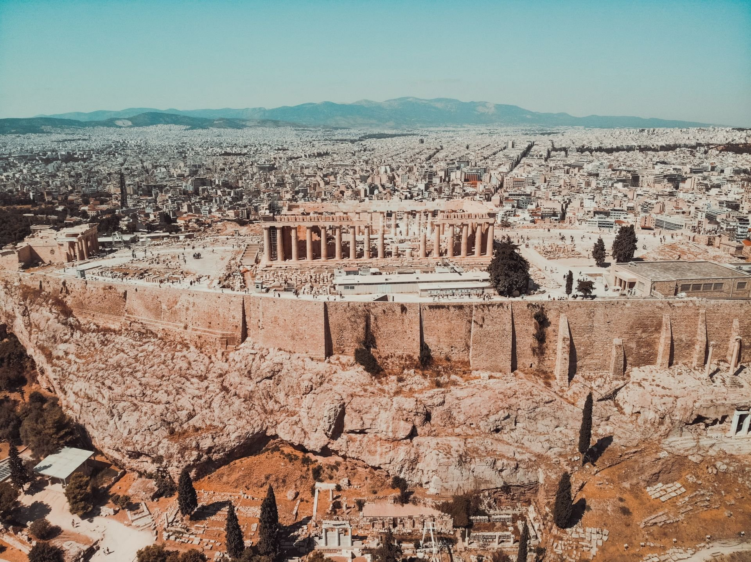

What is Athens…
?
?
…when it’s not the capital of Greece?
This presentation has no audio. Click for the next slide

Slide 2

E-mail – what e-mail?
What’s my Athens
password?
What if I’ve forgotten
my username?
AtA
Athens? It’s all
Greek to me!
What’s Athens?
Why isn’t my
login working?
FAQs
How do I change
my password?
How do I log in?
Is my Athens login the same as my
college login?
Can staff use Athens?

Slide 3

Athens isn’t an online resource in itself, like JSTOR or RILM
It’s what’s called an authentication system. By logging in you are
verifying that you are a student or staff member at the RNCM and
therefore have access to the range of online resources the Library
provides
That’s why you need to access many of our resources through Athens
when you’re working off-site, for example from home
Think of Athens as a kind of passport or stamp of
approval that confirms your right of access to our
online resources

Slide 4
When you start your course, your Athens login details are sent to you in an e-mail
These are not the same as the ones you use to login to your main college IT account
The following OpenAthens account has been created/modified for you. Username: rncstu20024321 The following link should be used to activate your account: www.openathens.net
username=rncstu20024321
activation_code=57*28C If you cannot follow the link, please copy and paste it into your browser.
At busy times it may be a few minutes before this link will work.
If you don’t see the e-mail, it’s worth checking your Clutter/Spam as well
If you still don’t see it, contact the Library on Libstaff@rncm.ac.uk
If you don’t activate your account it will eventually expire
If this happens, contact the Library and we’ll reset it

Slide 5
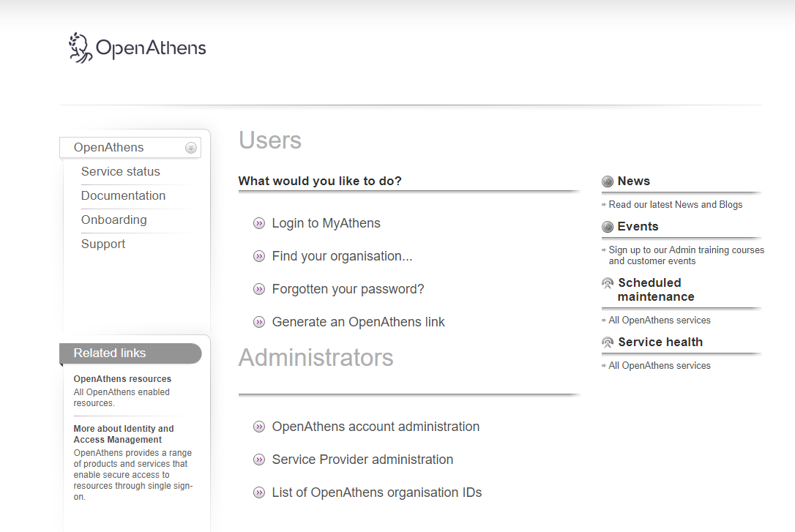
You’ll see that your username is the number on your college swipecard,
prefaced by “rnc”. This is useful if you can’t remember it
The Library also keeps a record of current usernames – but not passwords
To change, or if you forget, your password, go to the Athens website at
www.openathens.net
Your password should contain
8-20 characters with a mixture of
letters and numbers and/or symbols.
It mustn’t contain any consecutive
numbers or your username

Slide 6
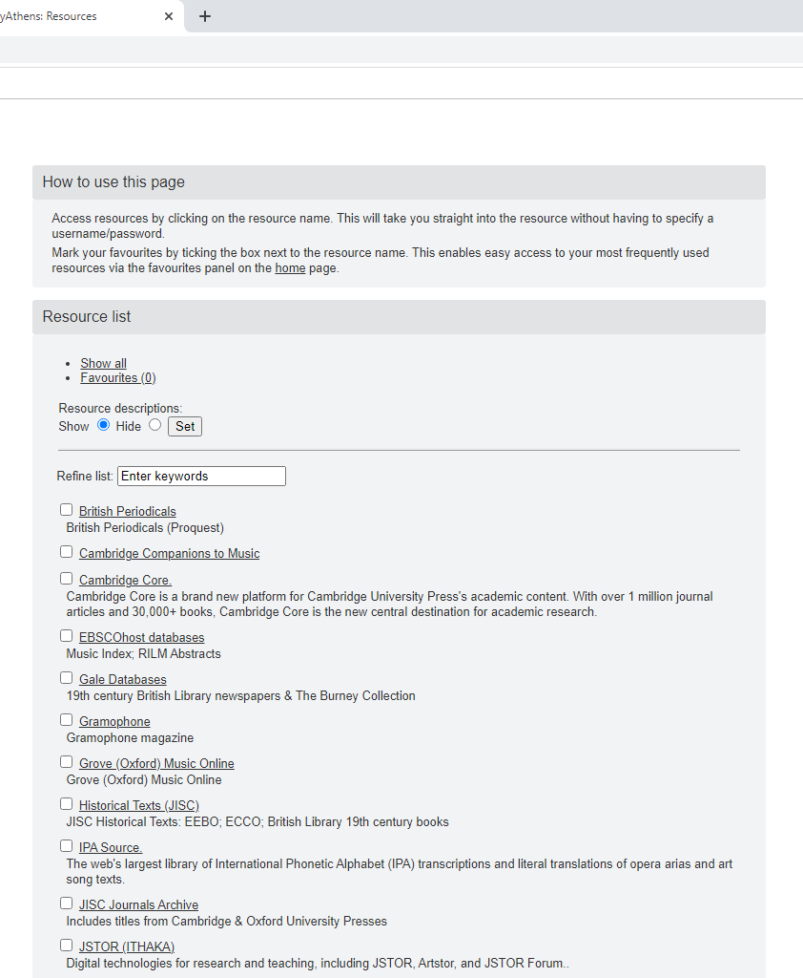




If you’re accessing online resources
offsite it’s easier to log in to Athens first
This way you can access all of our online resources without having to log in again

Slide 7
To sum up:
Athens is a system that verifies you have access to the Library’s online resources
All students and staff have an Athens account
Your Athens login details are e-mailed to you at the start of your course
These are not the same as the ones for your college IT account
The Athens website is www.openathens.net
If you log in to this you will see the full range of online resources
You can change your password on the Athens website
Your username is rnc plus the number on your college swipecard
If you have any problems contact the Library at libstaff@rncm.ac.uk

