Slide 1


USING THE ONLINE CATALOGUE
A guide to effective searching to help you get the most out of the RNCM Library catalogue

Slide 2
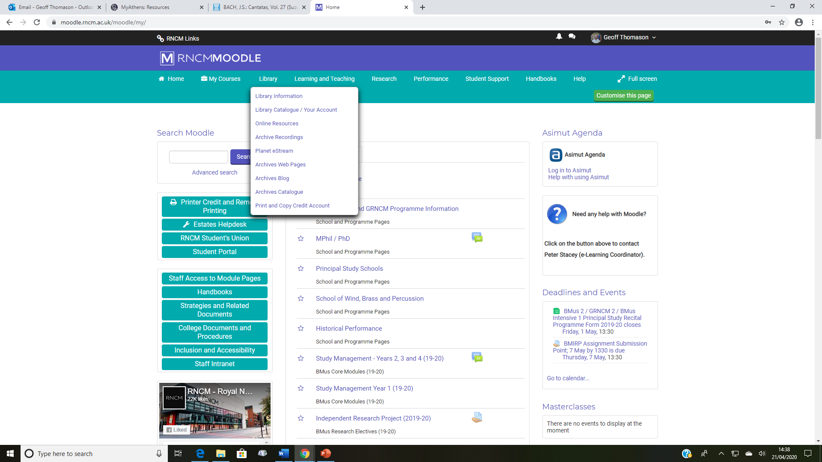

Slide 3
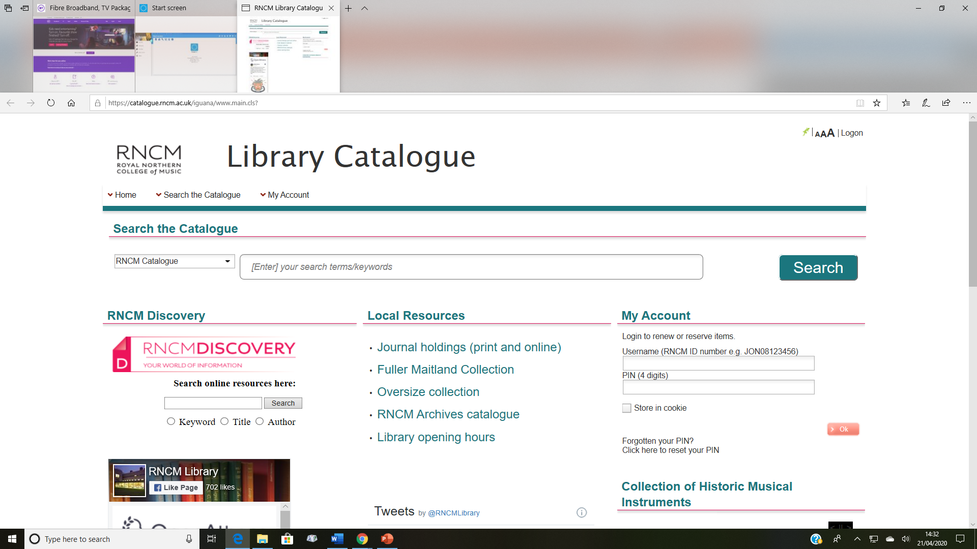

Slide 4
https://catalogue.rncm.ac.uk
…or Google ‘RNCM library catalogue’

Slide 5





Slide 6
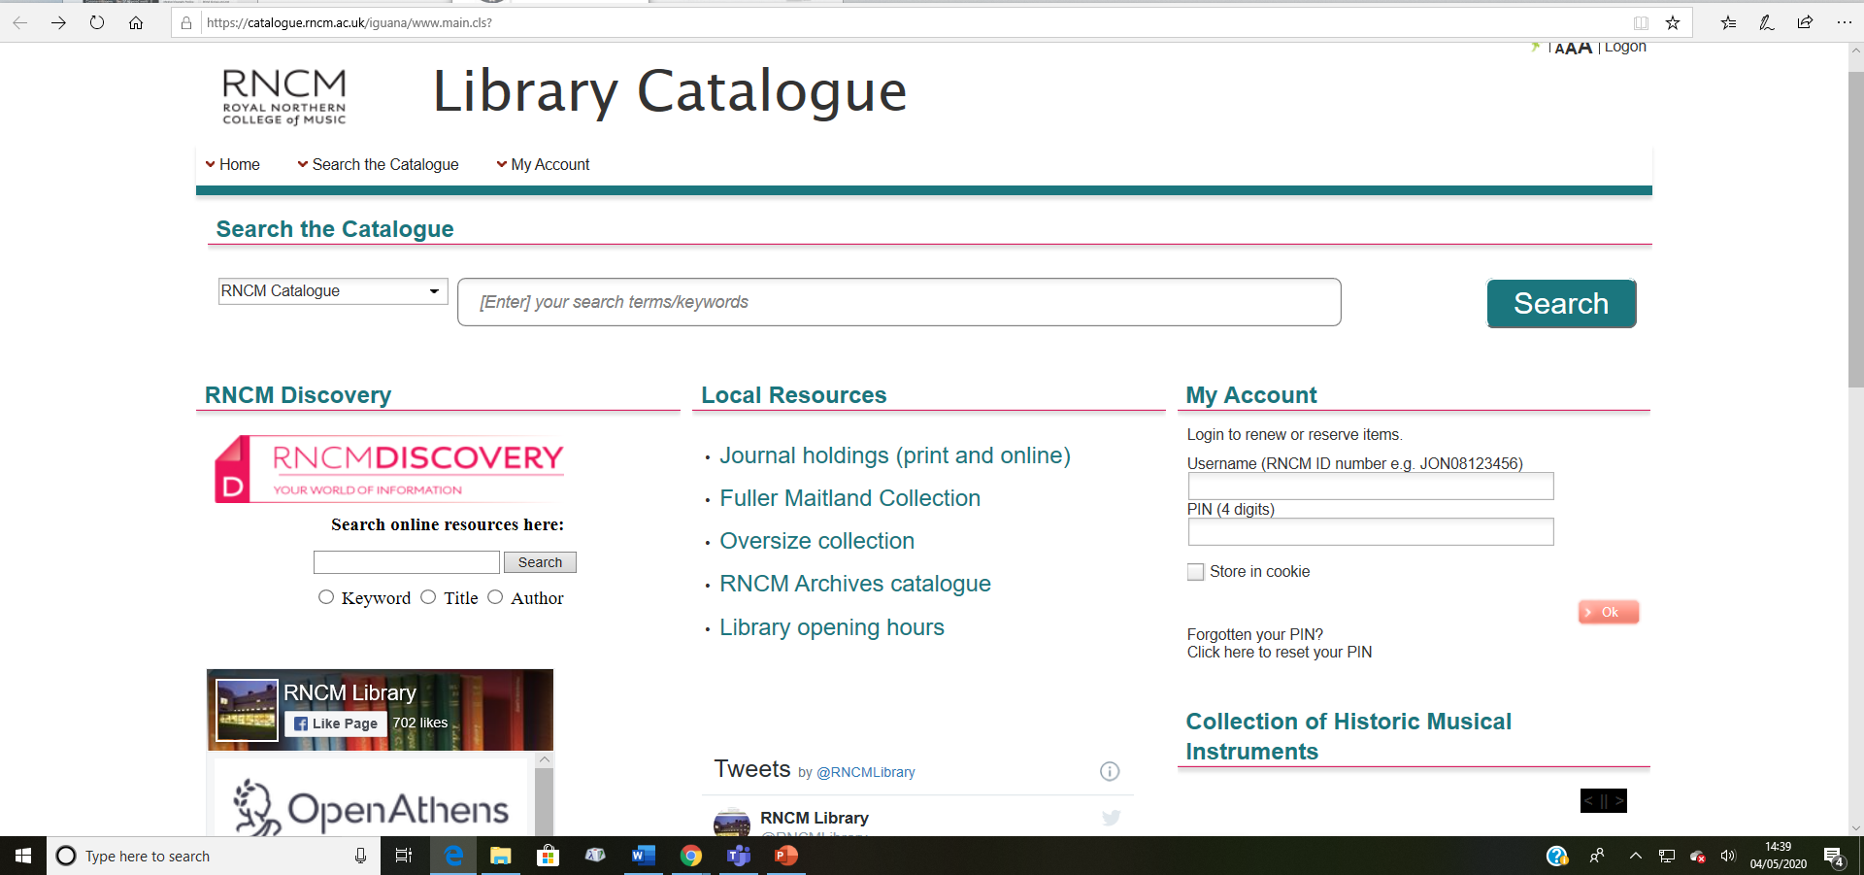

Slide 7
Using the Simple search
How do I find?

Slide 8
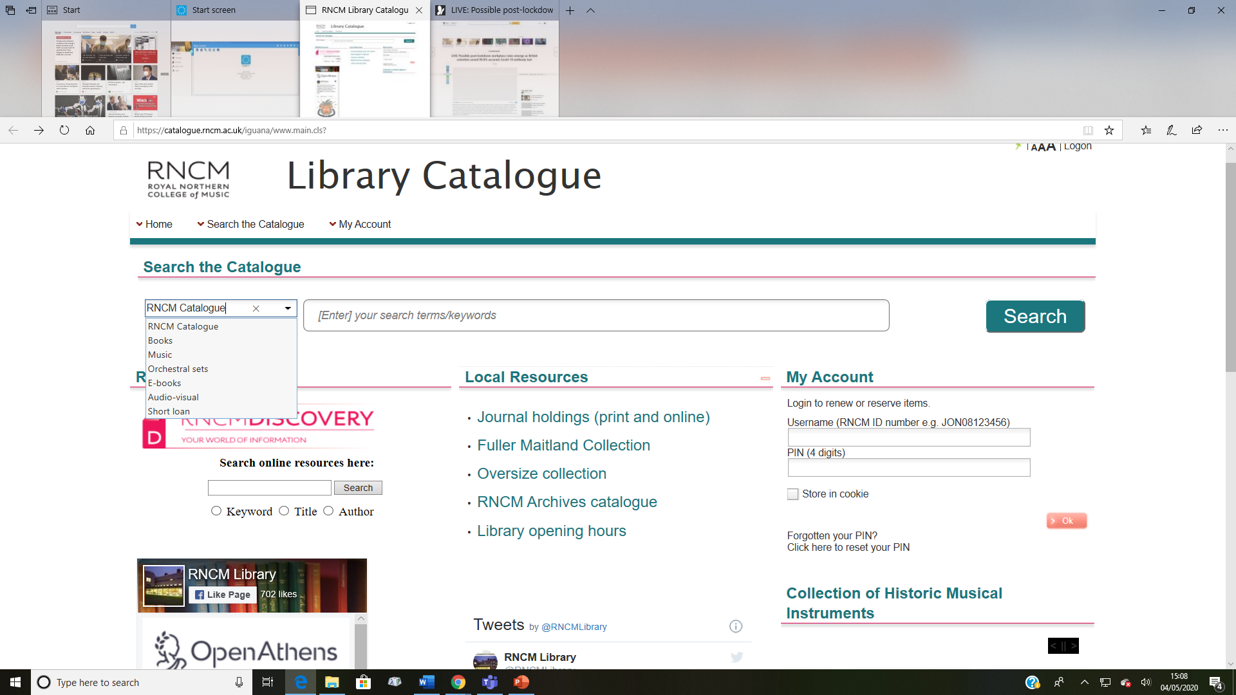

Slide 9
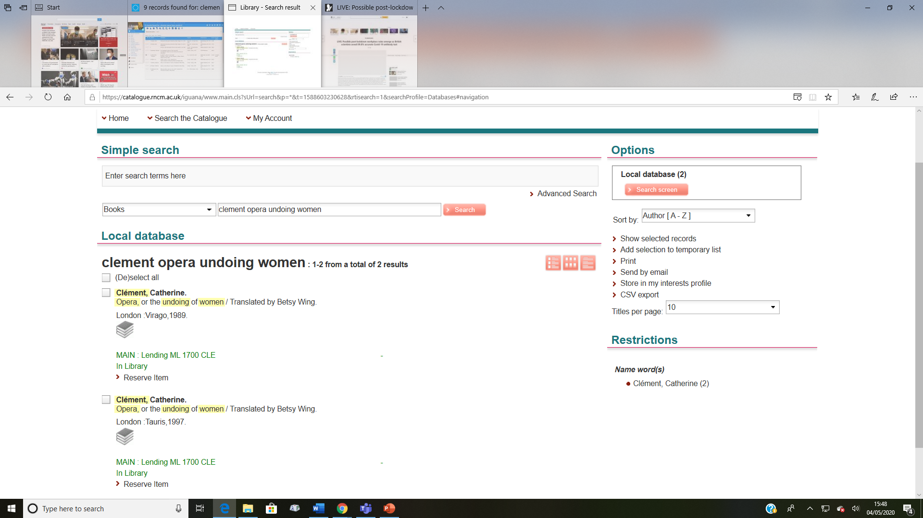

Slide 10
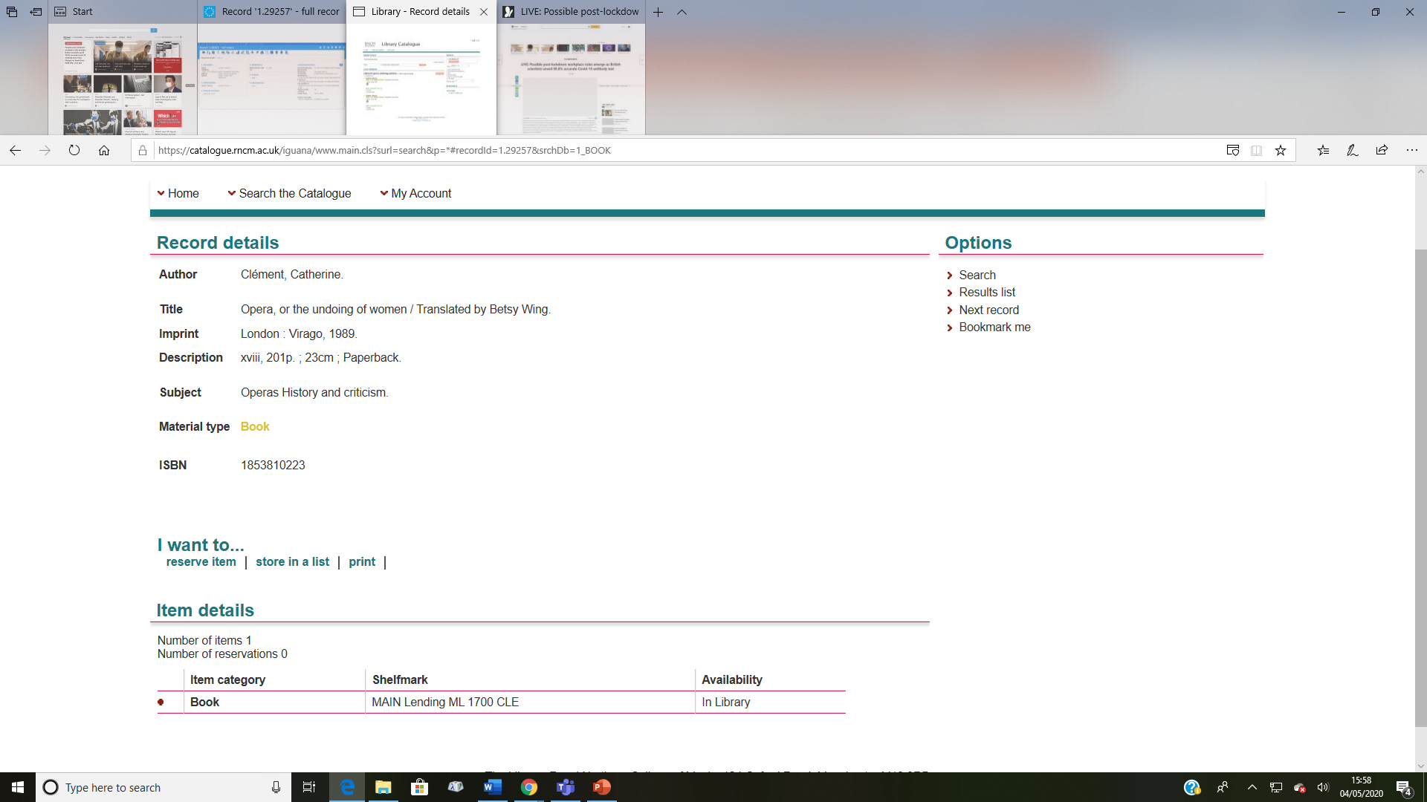

Slide 12

Beethoven
concerto
piano
no.5
op.73
E flat major
Emperor
miniature score
Eulenburg

Slide 13
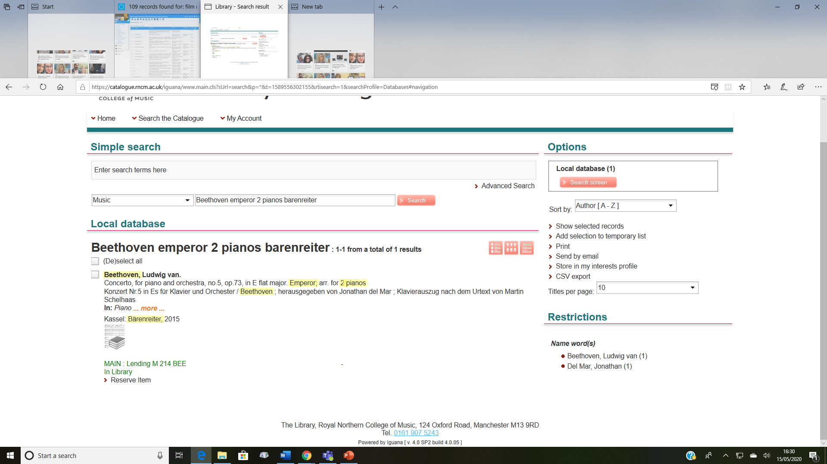

Slide 14
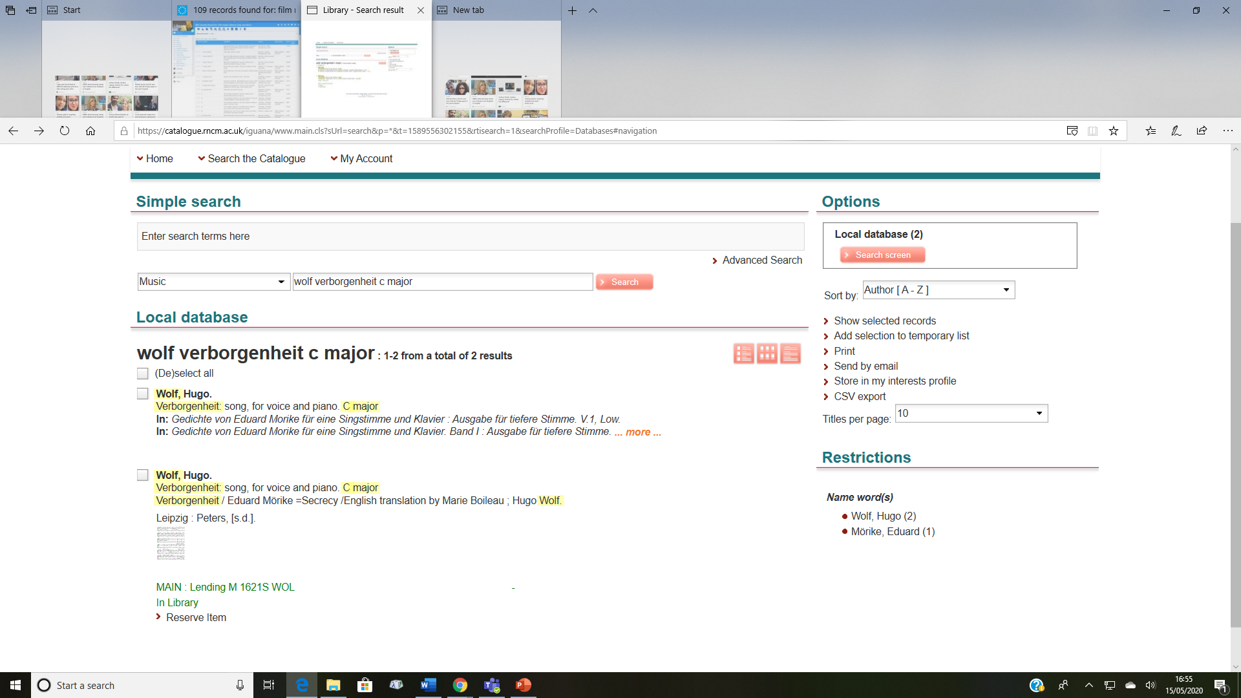

Slide 15
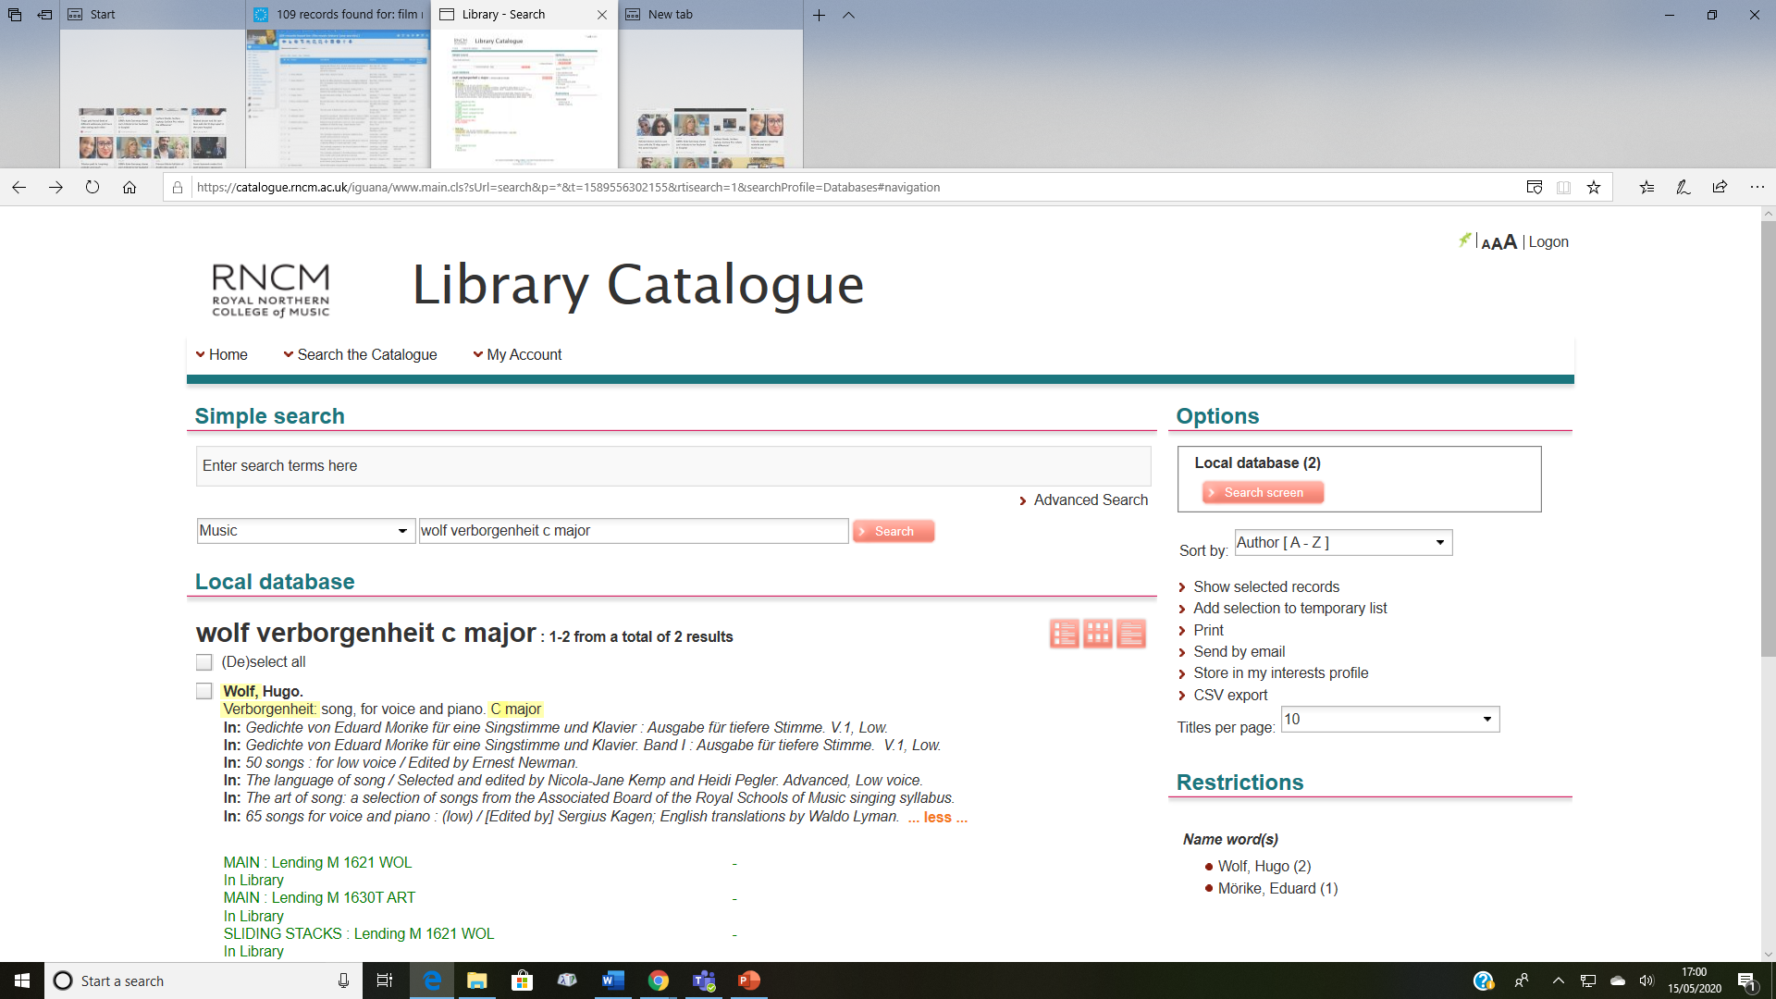

Slide 17
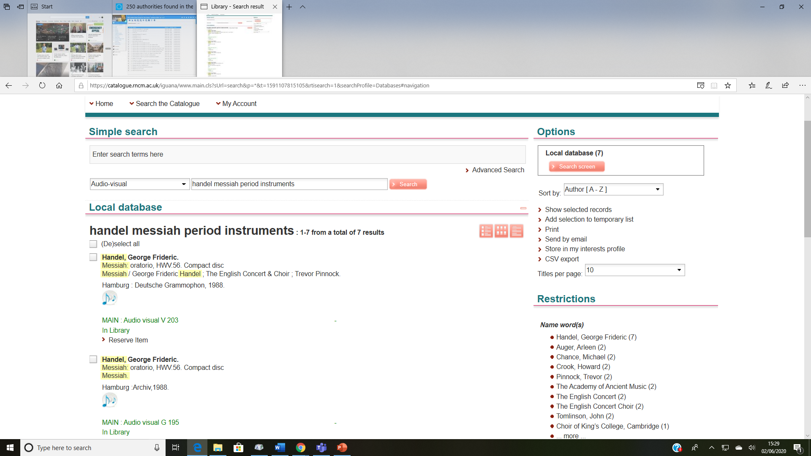

Slide 18
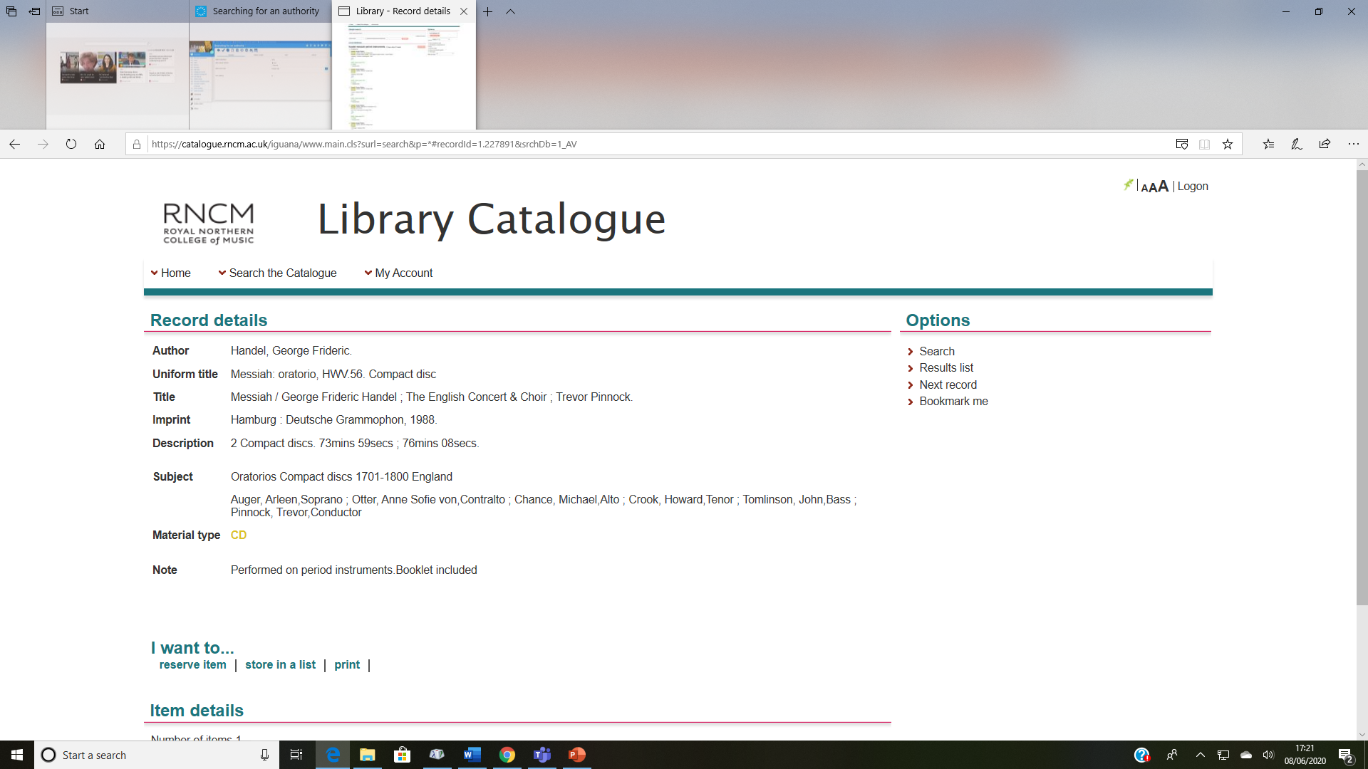

Slide 19
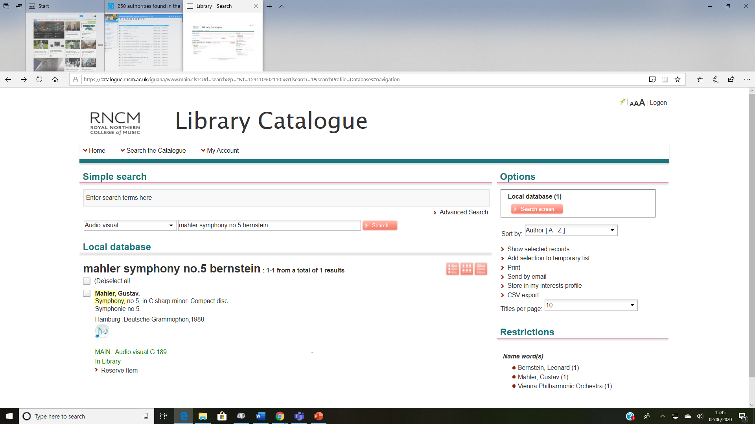

Slide 20
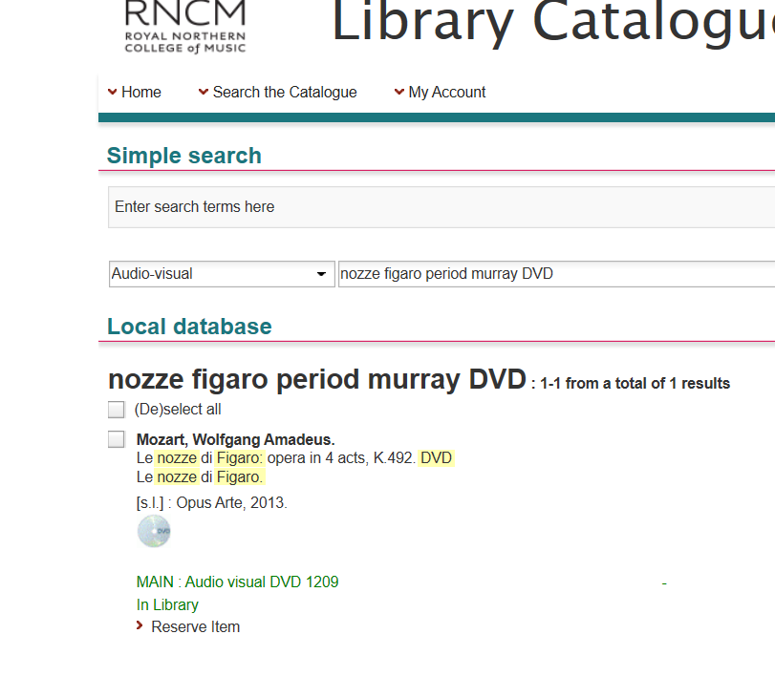
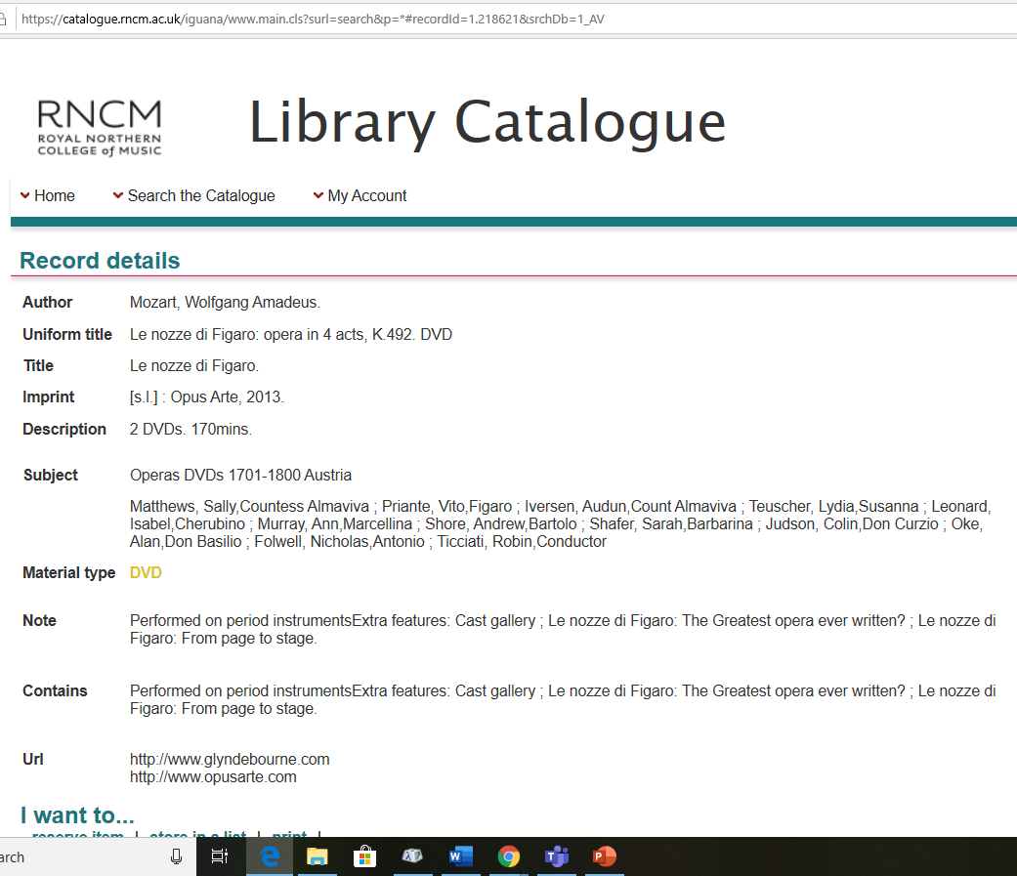

Slide 21
Do you have any books about…?
Do you have any music for…?
Are there any recordings of…?

Slide 22
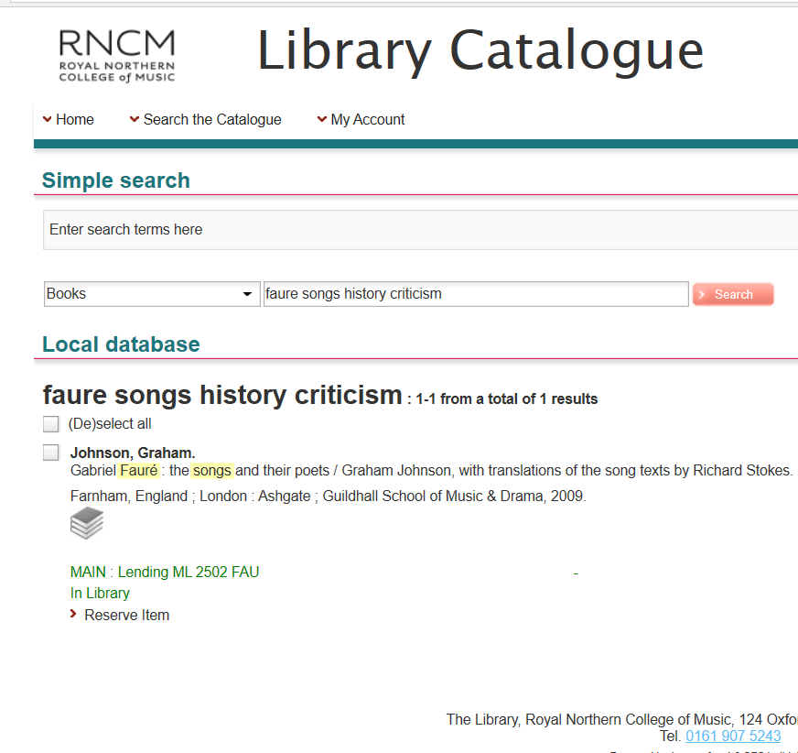
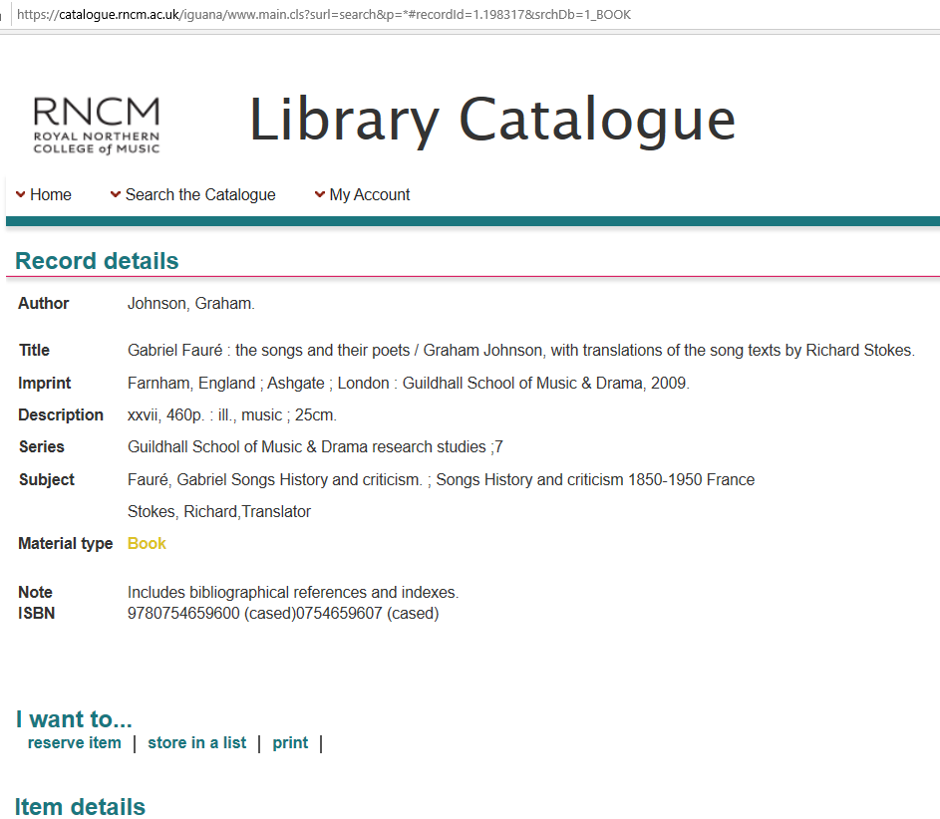

Slide 23

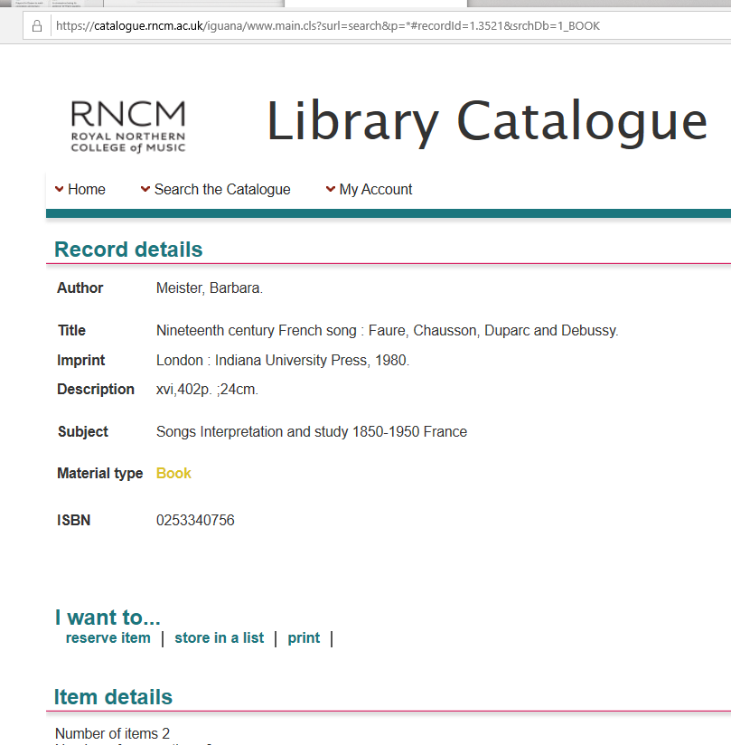

Slide 24
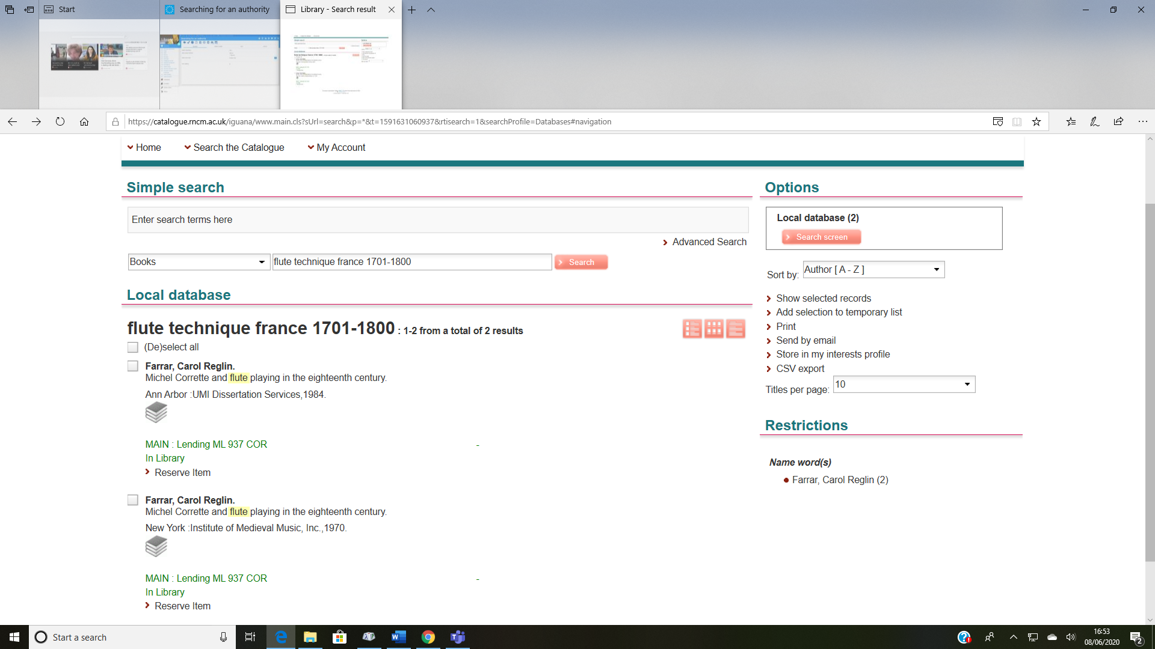

Slide 25
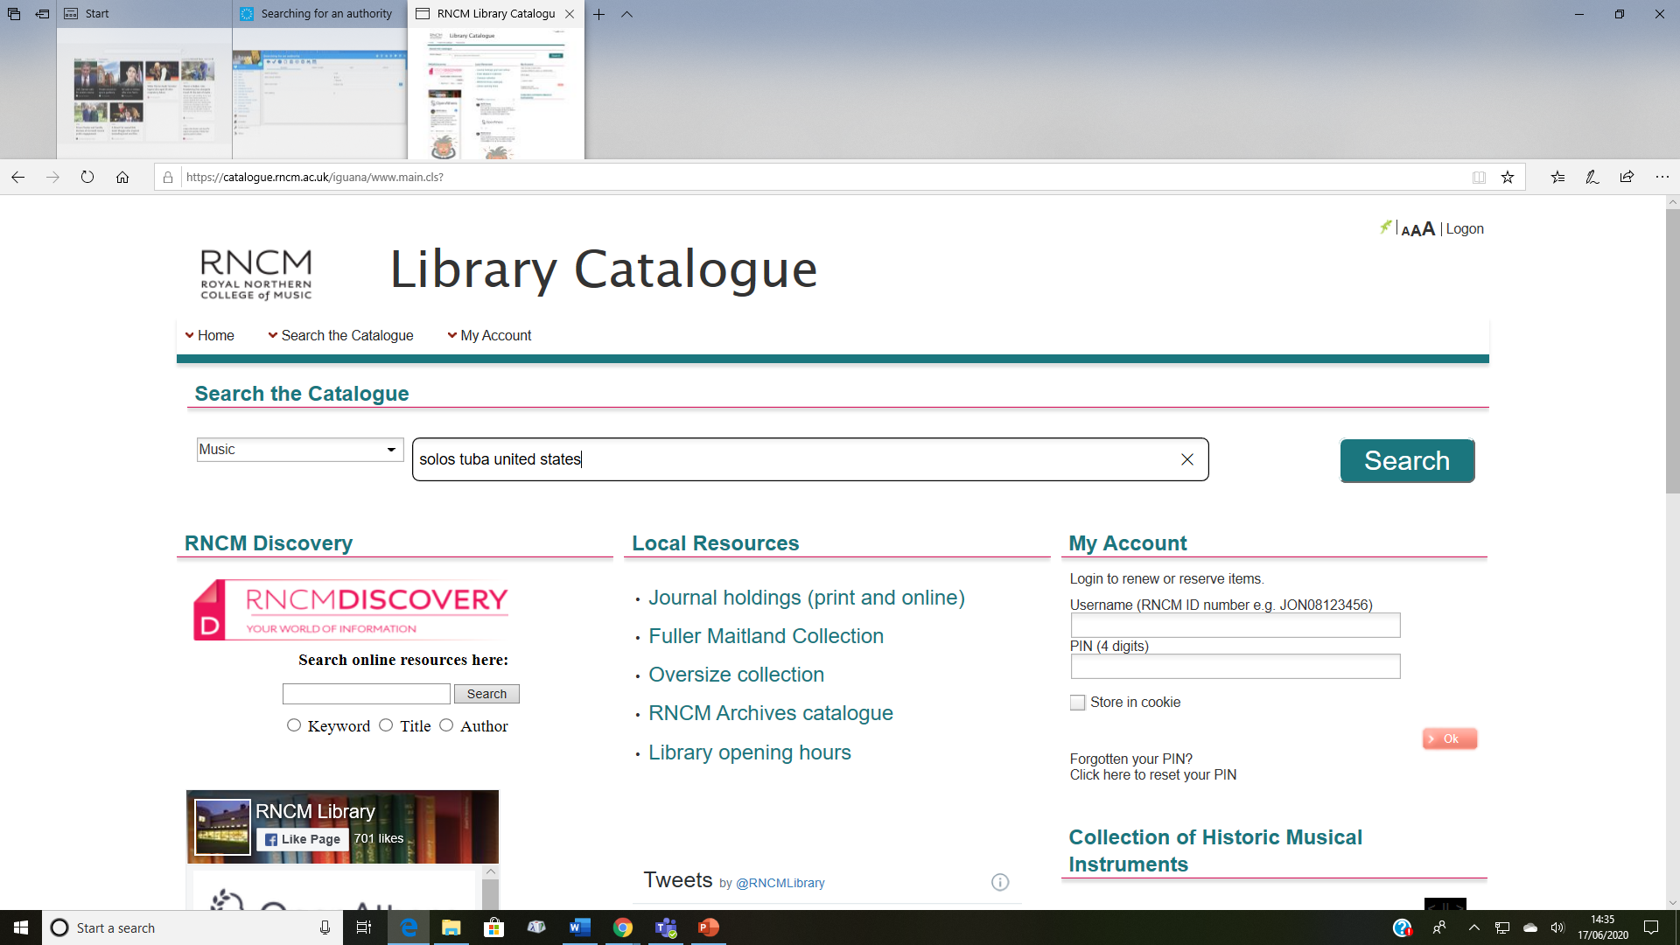

Slide 26
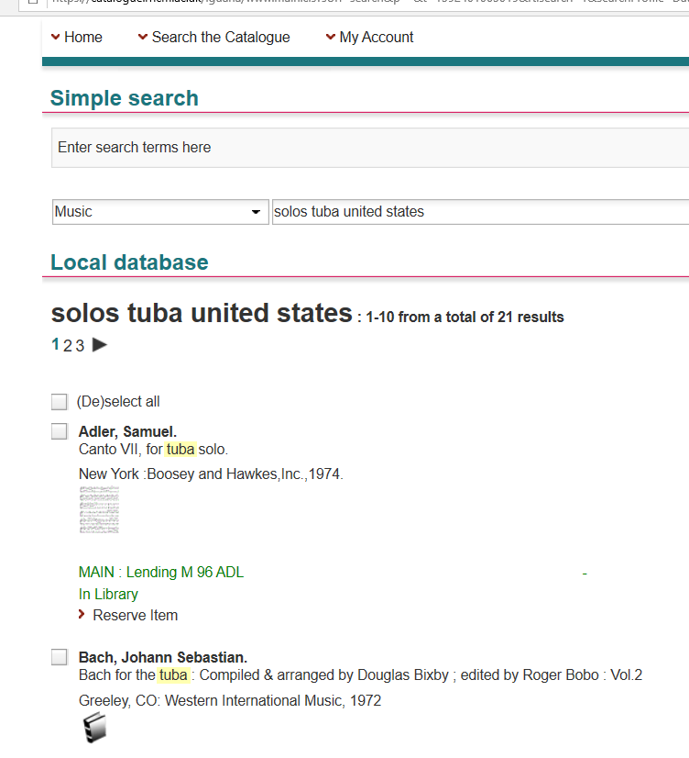
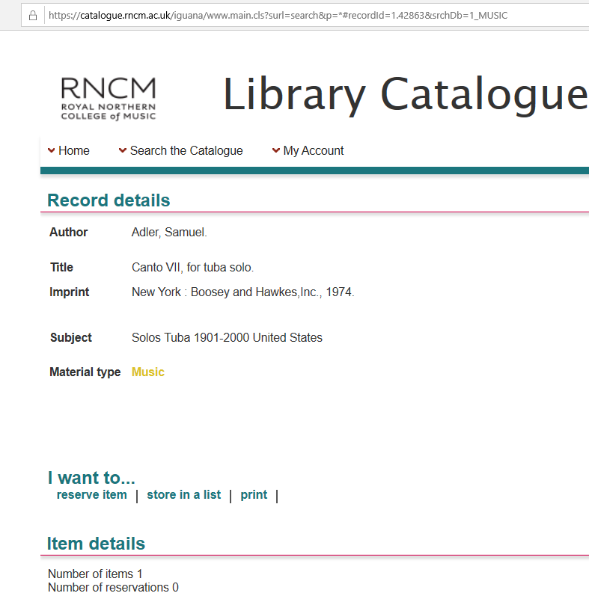

Slide 27
Using the Advanced search
What’s different?

Slide 28
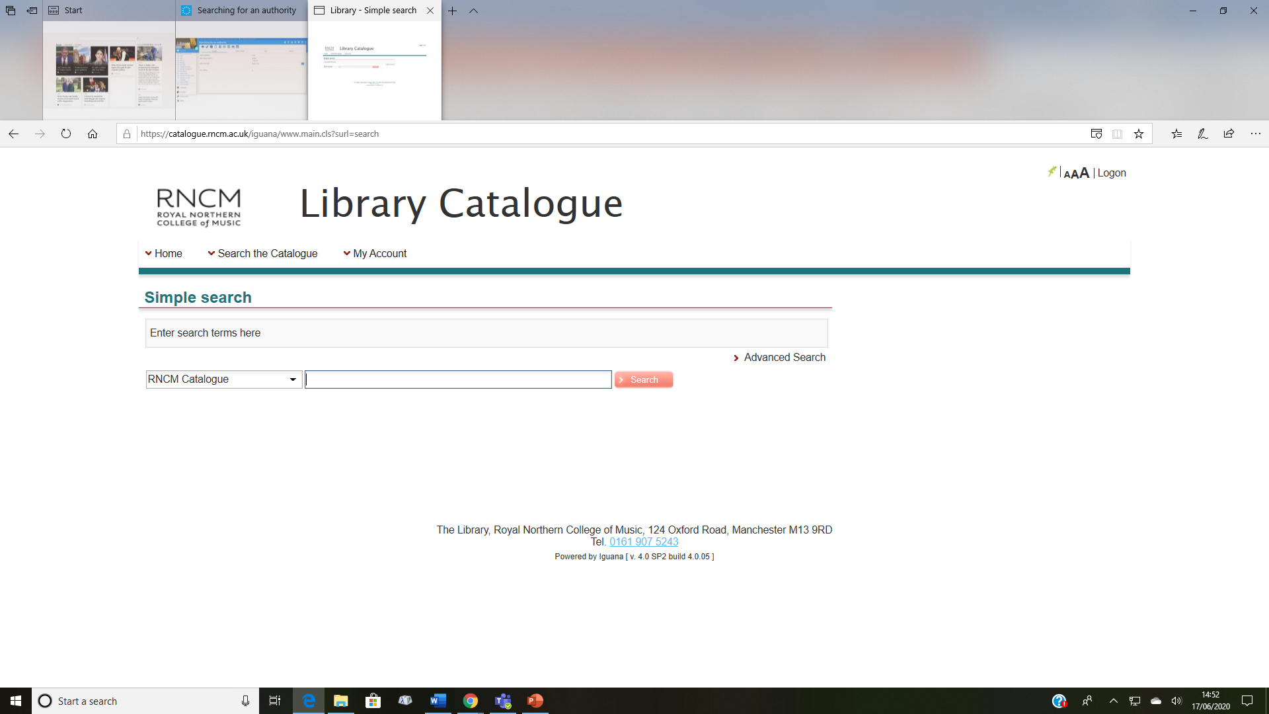

Slide 29


Slide 30
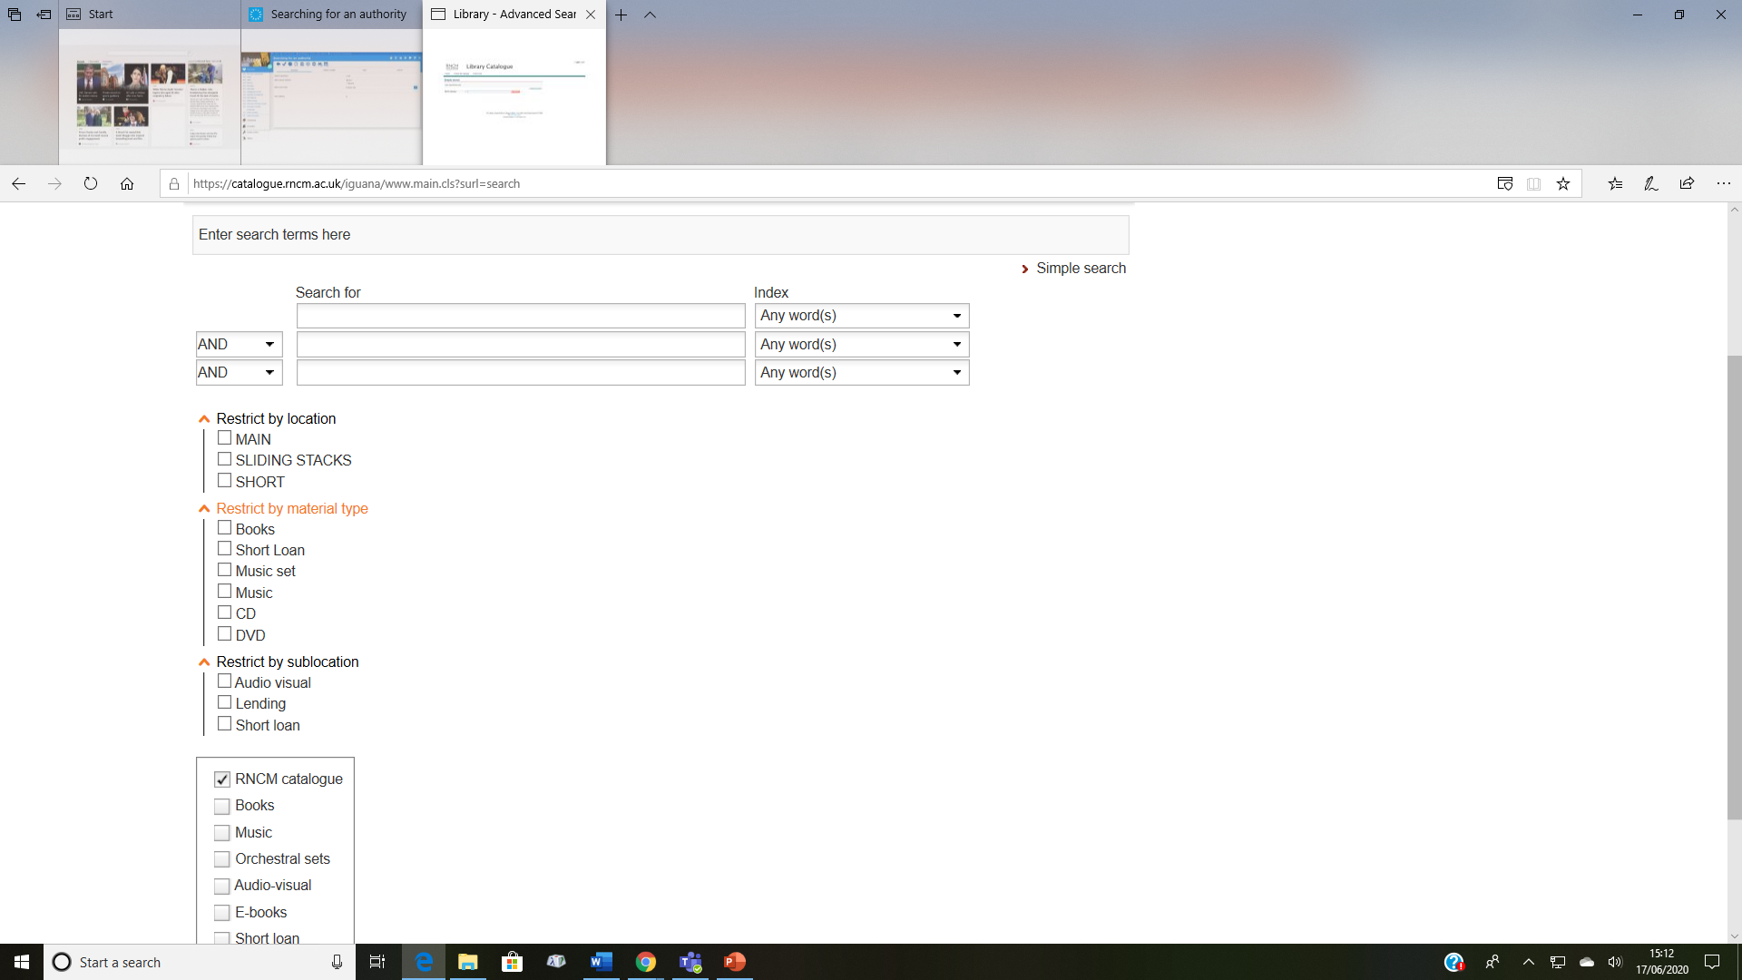

Slide 31
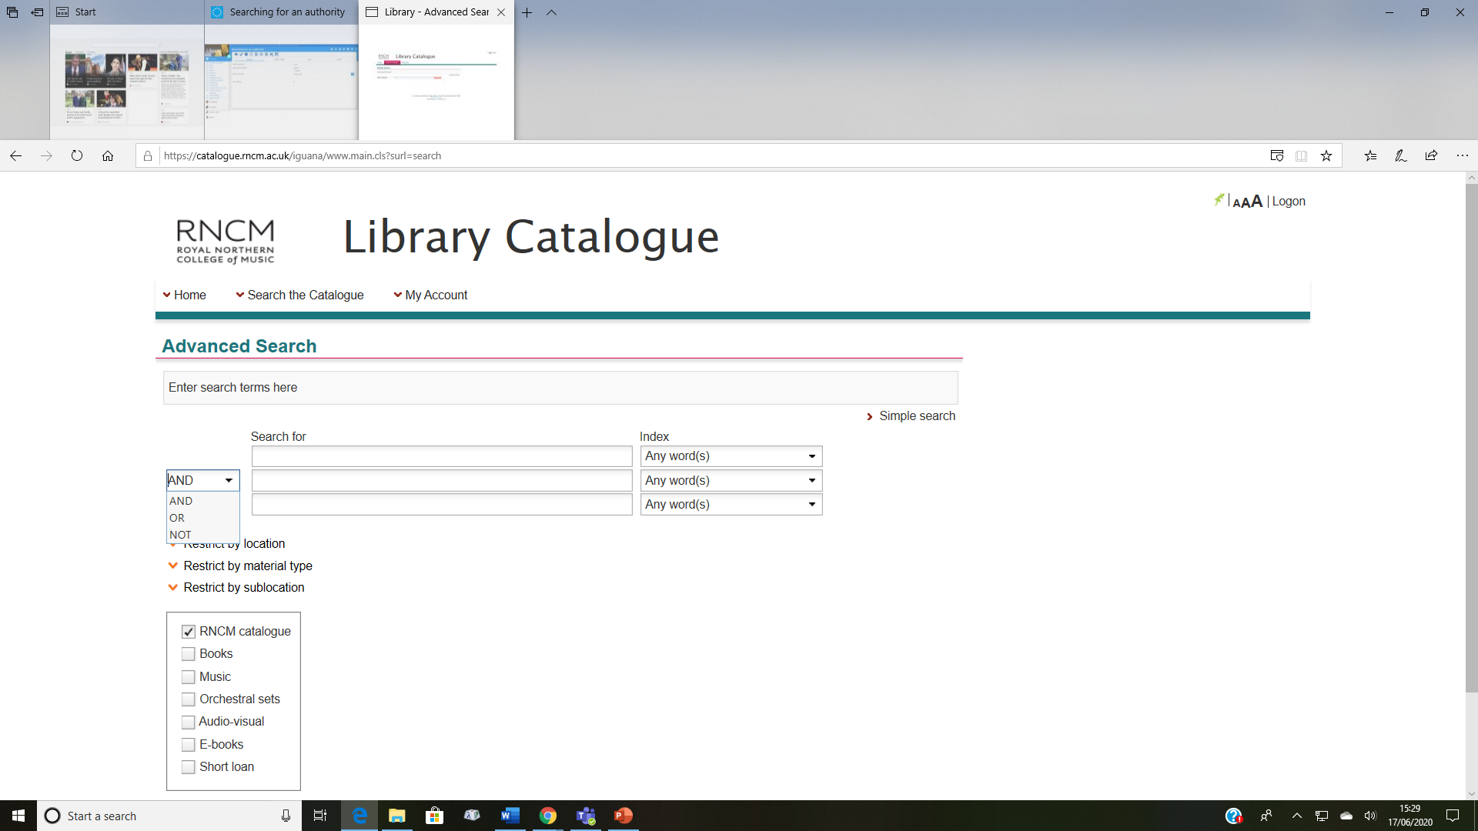

Slide 32
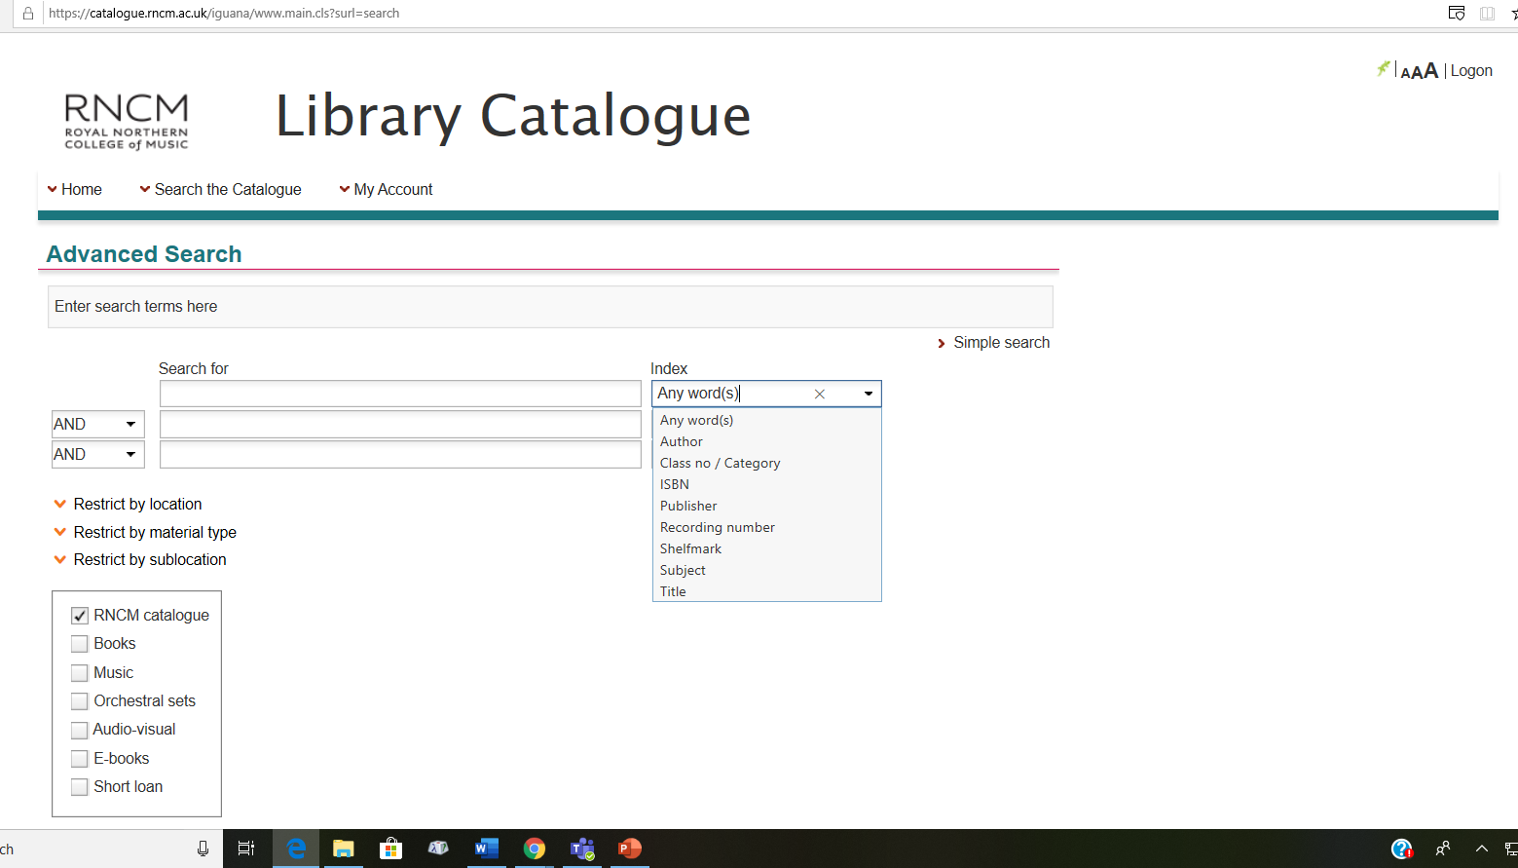

Slide 33
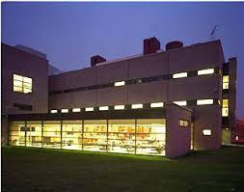
Thank you!
If you have any questions, please contact a member of staff

